Slide 1
Practice Session
Planning a faith for rights TRAINING event for your community
Notes:
The purpose of the Practice Session is to provide participants with hands-on experience in developing their own Faith for Rights training event to benefit their community. Options for practice sessions include:
1) a one-hour practice session at the end of a one-day training event,
2) an extended two-hour practice session at the end of a multi-day training event, or
3) multiple one-hour practice sessions during a multi-day training event.
The facilitator should choose the format that is most beneficial to the participants based on needs and context. However, including at least one practice session is required during any Faith for Rights training event.

Slide 2

How would a Faith for Rights training event benefit your community of influence?
The “Faith for Rights” framework facilitates exploring the relationship between religions, beliefs and human rights.
Notes:
Facilitators Notes
Engage the participants in a discussion about how a Faith for rights training event would benefit their individual communities. Some questions to ponder might be:
Are there human rights conflicts that impact people in your location?
Could there be better interfaith collaboration in your location?
What would the benefit be to those who are invited to participate?
The whole concept of Faith for Rights is interactive, result-oriented and conducive to critical thinking. It is open for adaptation by facilitators in order to tailor the modules to the specific context of the participants. Remind facilitators that as they begin to think about how the Faith for Rights framework can influence their communities, they may also consider how they would like to adapt the modules and content to their specific contexts.
If the Brainstorming activity was used during the Introductory Session (Module 0), participants may have engaged in a discussion in which they discussed elements of a training session on faith and human rights. If so, remind participants to refer to their notes. What were their suggestions at that time? How could they incorporate those now?

Slide 3
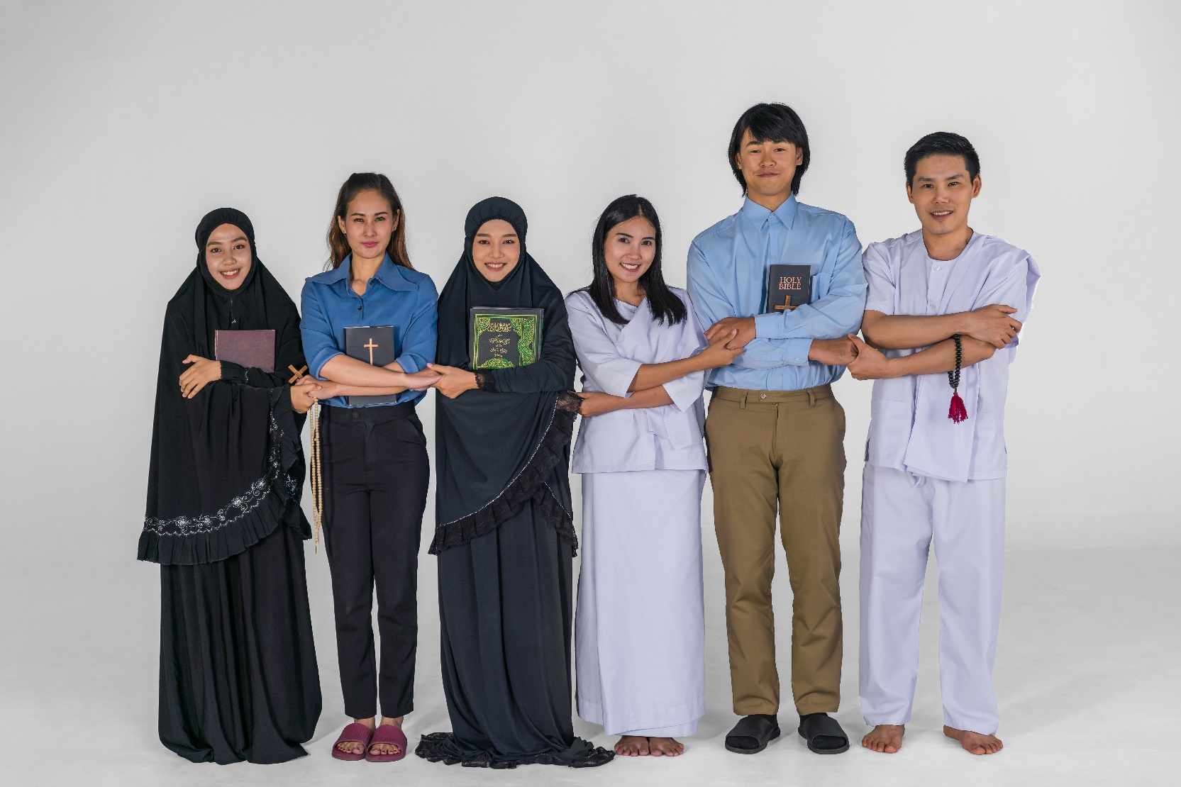
Who is my community?
Plan your training event with attendees in mind:
Interfaith groups
Student groups
Religious congregants
Notes:
Ask the participants to think about their local communities. Community structure will vary from participant to participant. For example, some participants may be leaders of religious congregations or communities. Others may be active in interfaith groups or student groups. Others may be human rights educators. Invite participants to think about their own unique circumstances and communities of influence. Invite them to think about their contacts and connections within these communities. Invite them to determine those who may exhibit leadership characteristics and others they feel would benefit from participating in Faith for Rights training. Invite participants to list these colleagues on their Faith for Rights Planning Guide.

Slide 4

Is there a conflict to address?
If your community has a conflict related to faith and human rights, consider the following:
What is the conflict?
How can Faith for Rights be part of the solution?
What modules apply to the conflict?
Notes:
Participants will come from a variety of backgrounds. They may be well aware of conflicts between faith and human rights in their local communities. Others may not see specific problems. Faith for Rights can be a useful tool in educating individuals on how faith and rights can work in harmony to achieve peaceful societies. Participants may want to consider addressing specific conflicts as they work to plan potential Faith for Rights training events. If they do not intend to focus on a conflict in their community, encourage them to select one or more of the modules from the Toolkit that would be of interest to the community members they have identified.

Slide 5
Determine a Format
Format
Venue
Participants
One day event
Multi-day conference
Weekly 90-minute sessions
Notes:
The following information is contained in the Faith for Rights Planning Guide:
Remind participants that because the nature of the Faith for Rights framework is adaptable, participants may choose the length or structure of the training event they plan.
Below are some ideas for Faith for Rights sessions:
90-minute sessions held weekly. This is ideal if you are interested in facilitating sessions on multiple modules, but do not have time or resources for a full day or multi-day conference.
A one-time Faith for Rights training event. This could take place over the course of one day, or could be useful for a training event on one specific topic contained within the Faith for Rights modules.
A one-day Faith for Rights training event. During a day-long training event, you have the freedom to explore one module in-depth or focus on multiple modules and topics.
A multi-day conference. This format would be ideal for gatherings of faith leaders from various locations and backgrounds. It would also be ideal for religious or educational institutions.
When determining your format and planning your session(s), a facilitator should take into account the following:
The time available for your training event
The number of participants
The education background of participants
The purpose of your event
The facility in which you will host the event
The specific topics that you would like to address during the event

Slide 6

Purpose
Location
Date & Time
Topics
Education background of participants
Notes:
Invite participants to utilize the Faith for Rights Planning Guide as they create an outline for a potential Faith for Rights training event for their own community. You may want to invite participants to work individually, in pairs or in small groups. Remind them to consider the following:
The time available for your event
The number of participants
The education background of participants
The purpose of your event
The facility in which you will host the event
The specific topics that you would like to address during the event
ALTERNATIVE: Divide into small groups to discuss potential formats and outlines for a Faith for Rights training event
NOTE: If your training event is longer than a single day, a second Practice Session should be provided to allow participants to explore the Faith for Rights toolkit further in order to select module content that they would like to incorporate into their training event. If this is the case, inform the participants that they will have additional time to work on their plan.

Slide 7
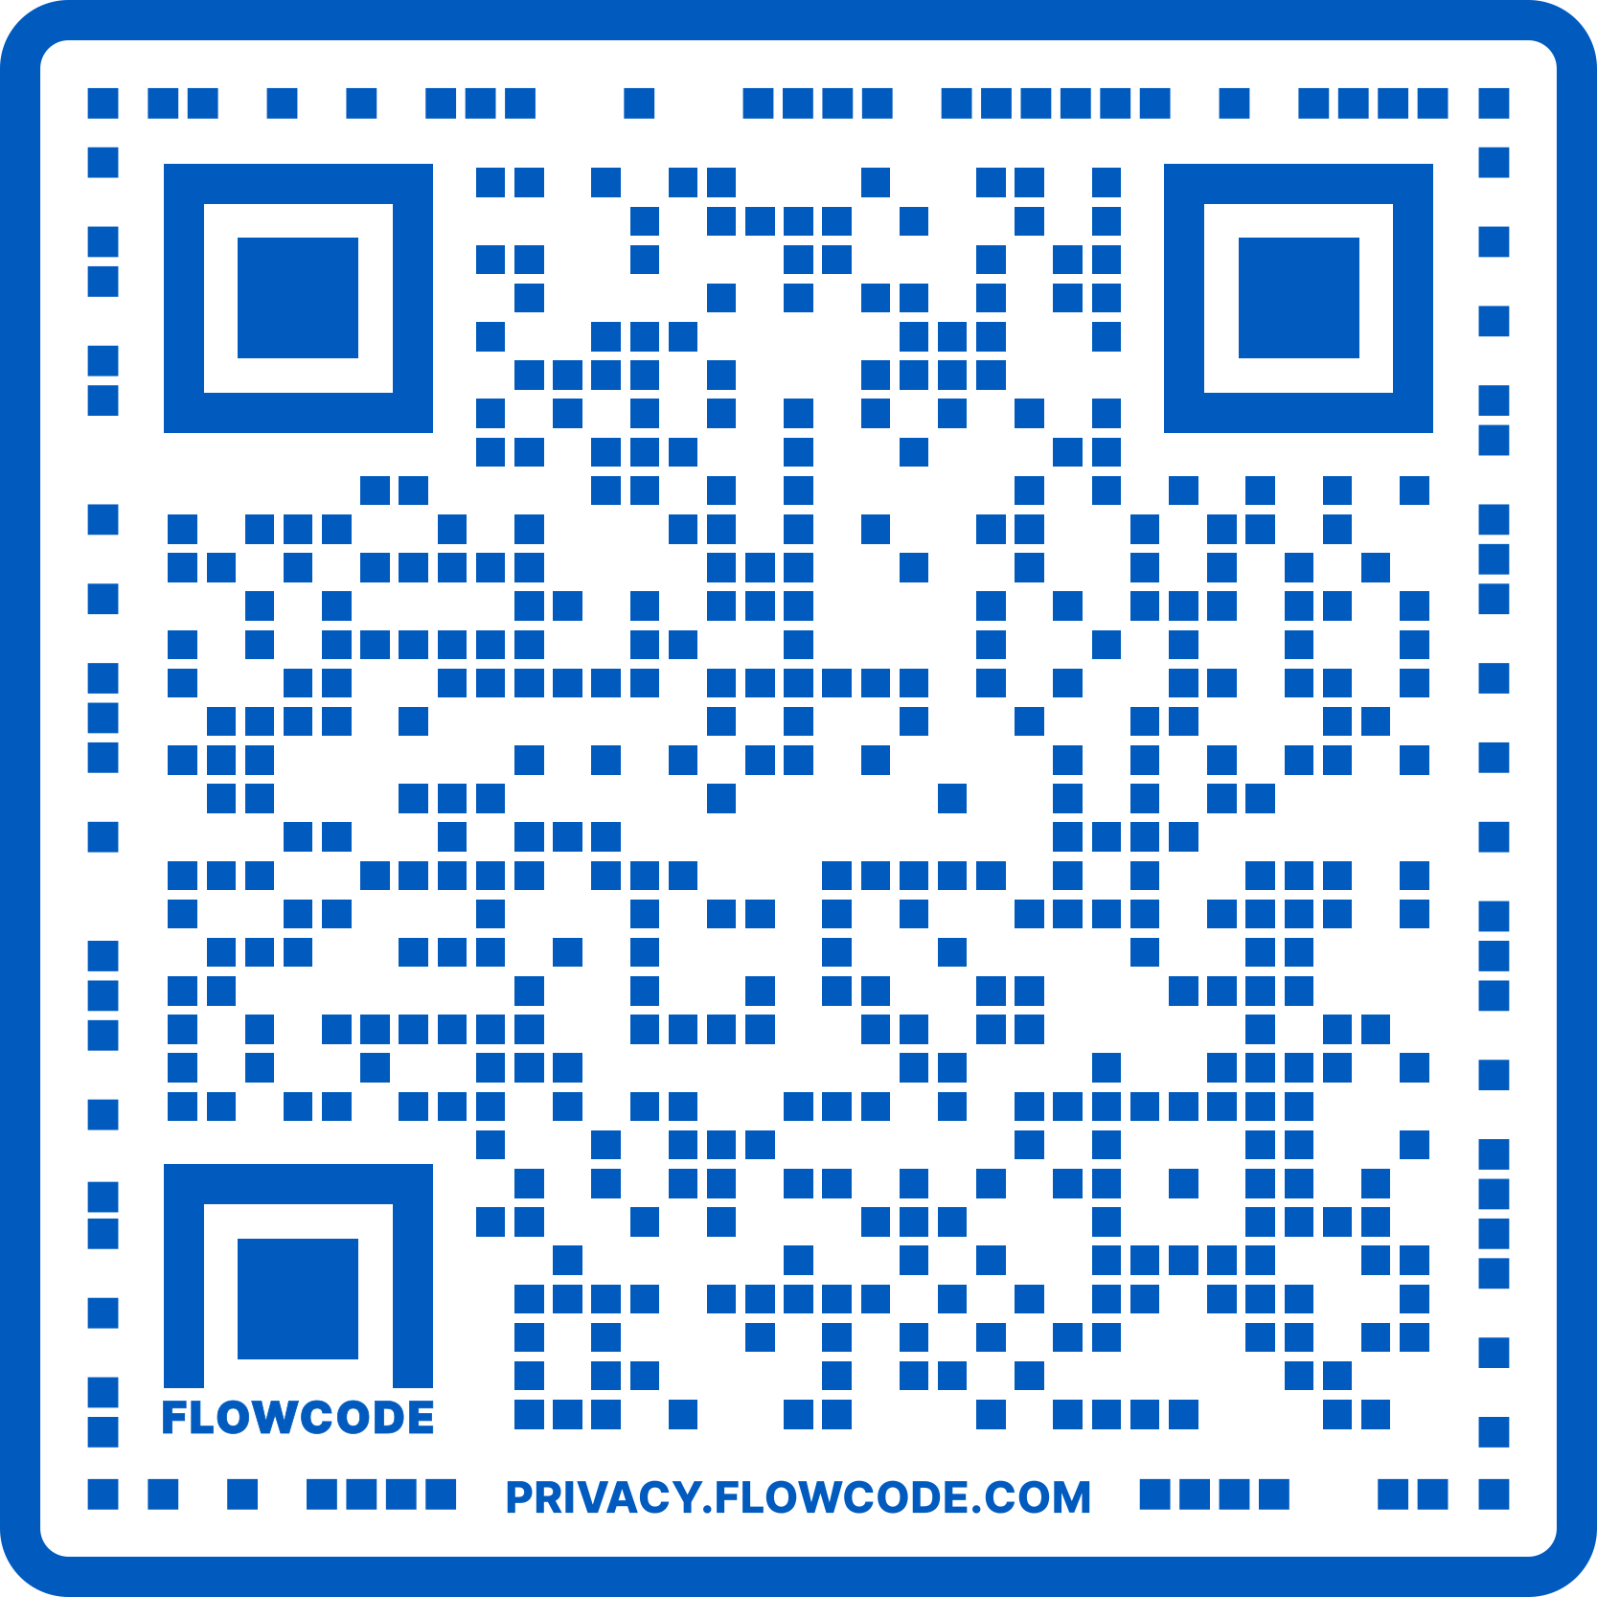
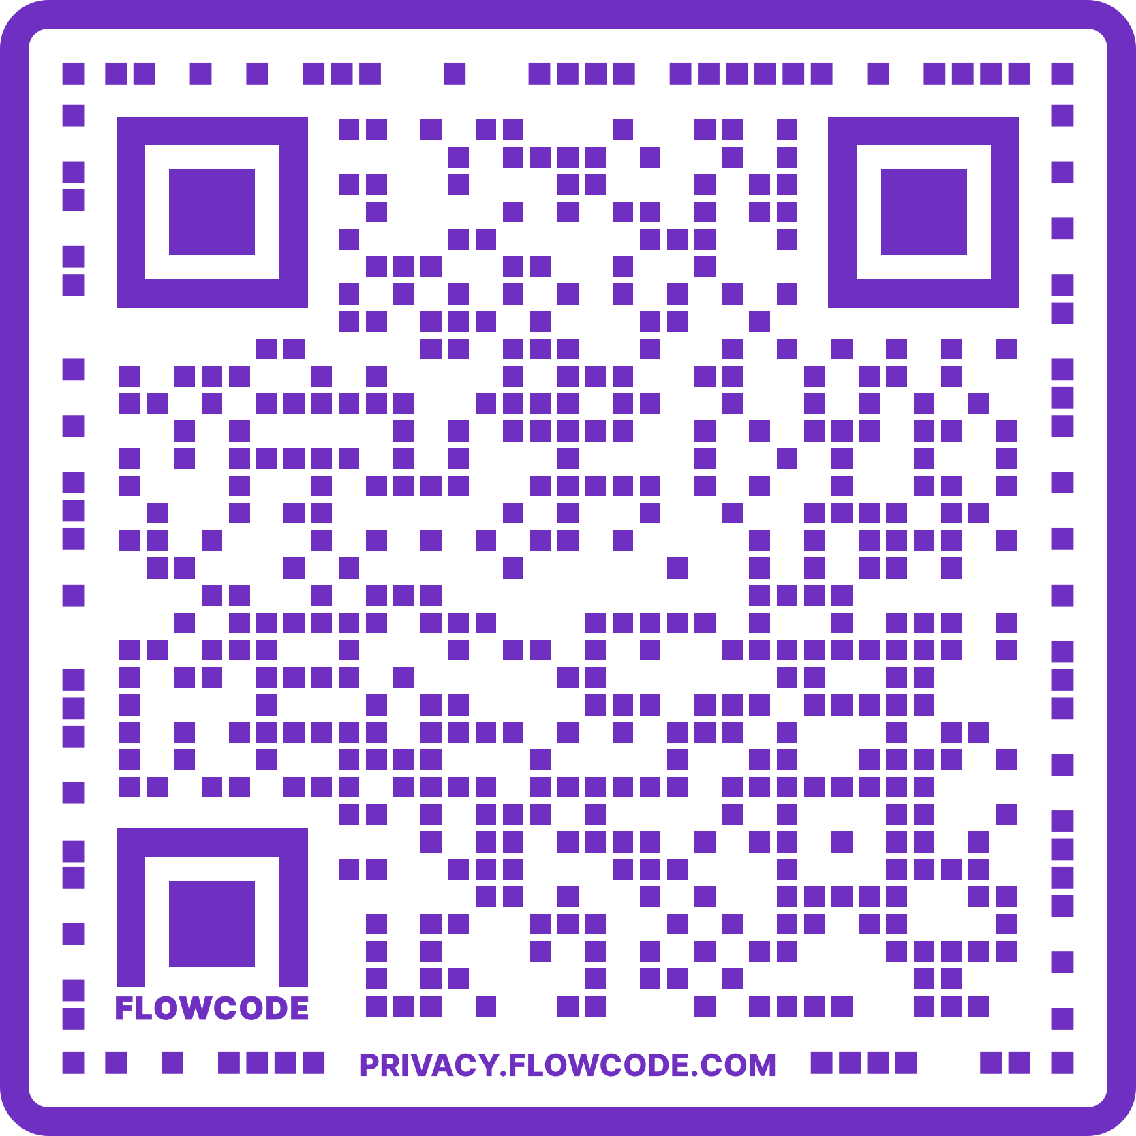
Additional Resources
Faith4Rights.ICLRS.org
Additional module content
A Facilitator Training online course
USIP A "Faith for Rights" Approach to Promoting Sustainable Peace
An independent online course
Notes:
This is likely the final session of the training event. Thank the participants for contributing to the event and encourage participants to scan the QR codes to do other related courses on Faith for Rights (for instance, BYU/ICLRS and USIP) and, most importantly, organize their own training events. At this point, they are well-prepared to conduct their own training events.

