Slide 1
Module 7 of the #Faith4Rights toolkit
COUNTERING Incitement to hatred
Notes:
Facilitator Notes:
This session uses the #Faith4Rights toolkit, specifically module 7. This peer-to-peer learning module emphasizes discussion and participant interaction.
This module focuses on free speech, hate speech and incitement to violence or discrimination.

Slide 2
Commitment VII
“We pledge to publicly denounce all instances of advocacy of hatred that incites to violence, discrimination or hostility, including those that lead to atrocity crimes. We bear a direct responsibility to denounce such advocacy, particularly when it is conducted in the name of religion or belief.”
Notes:
It would be useful to refer participants to the full commitment, and read it out. The point of this slide is to provide background to the participants and provide an anchor for the discussions in this session.
Reading aloud the commitment at the outset ensures that all participants focus their minds on it. Take the first 5m of the session to read the commitment, and emphasis the role that religious leaders have in this commitment. Some religious leaders may themselves incite others to hatred against followers of other religions or atheists in their own attempt to preach their own religion. This may also interact with political populism, so that some politicians may manipulate religious discourse to suit their own agenda. As such, religion has the potential to be used as a tool to harm rather than as a force for good.
Once the whole commitment has been read out, with the emphasis on the key terms in it, take 10m to take on the Tweeting exercise which is found in the peer-to-peer learning exercises in module 7. Participants are asked to summarise the commitment in less than 140 characters. This will help the participants to de-construct and understand the commitment. Participants should be encouraged to tailor the summary to their own community. It may be useful to frame the question in terms such as “how can the main points of this commitment be put simply, in a clear and concise way that people in your community would understand?”. This can be done with small groups of 3-4.

Slide 3
Peer-to-Peer Exercise:
TWEETING COMMITMENT VII
  Summarise this commitment in less than 140 characters and decide how to articulate Commitment VII in your own words.
Notes:
Once the whole commitment has been read out, with the emphasis on the key terms in it, take 10 minutes to take on the Tweeting exercise, which is found in the peer-to-peer learning exercises in module 7.
This exercise is intended to de-construct and re-construct the commitment to reenergize the discussions.
It may be useful to frame the question in terms such as, "how can the main points of this commitment be put simply, in a clear and concise way that people in your community would understand?". This can be done with small groups of 3-4.
One possible result could be as follows: "We commit to publicly denounce all instances of advocacy of hatred that incites violence in the name of religion or belief".

Slide 4
Module 7
  International Covenant on Civil and Political Rights
  Article 19(2)
  “Everyone shall have the right to freedom of expression; this right shall include freedom to seek, receive and impart information and ideas of all kinds, regardless of frontiers, either orally, in writing or in print, in the form of art, or through any other media of his choice”
Notes:
This module from the #F4R toolkit builds primarily on the right in Article 20(2) of the International Covenant on Civil and Political Rights. The fundamental principle of non-discrimination that underlies the human rights system requires outlawing any incitement to violence.
Sadly, we have seen the effects of such incitement all too often.
However, Article 20 (2) of the ICCPR is an exception to the right to freedom of expression, as written on slide 4. Clarify to the participants that in most situations, people have the right to freedom of expression. However, like freedom of religion or belief, this right can be limited in exceptional circumstances. Incitement to hatred is one of them.
In the next few slides, examine human rights and link this commitment to those human rights. It would be useful to make those links explicit with each slide on how this relates to the commitment to counter incitement to violence.

Slide 5
Module 7
  International Covenant on Civil and Political Rights
  Article 20(2)
  “Any advocacy of national, racial or religious hatred that constitutes incitement to discrimination, hostility or violence shall be prohibited by law”
Notes:
On this slide, emphasize how incitement to violence has been prohibited as part of international human rights law by the International Covenant on Civil and Political Rights.
Also emphasize that States that are party to the ICCPR must implement this article in their legislation.
The prohibition by law does not necessarily means by criminal law. However the state must prohibit this type of incitement to hatred.

Slide 6
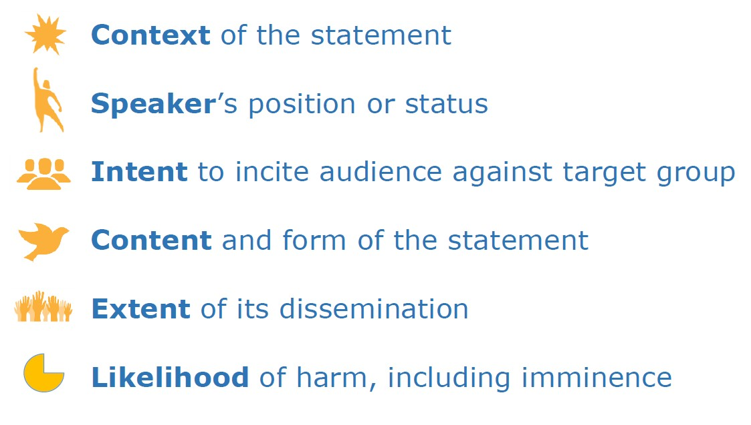
Rabat Plan of Action
A test elaborated by experts from all around the world to consider instances of hate speech
Notes:
While it is important to curb hate speech, law is a blunt instrument to limit freedom of expression. In some cases, States can use these laws to prosecute critics of the government or members of minority religious groups. Therefore, it is very important that each case is analyzed carefully.
Demarking the line where speech crosses over from undesirable to incitement to violence, hatred or discrimination is not easy. The Rabat Plan of Action of 2012 provides 6 key factors that can be used to assess whether speech should be treated as hate speech and prohibited by Article 20, paragraph 2 of the International Covenant on Civil and Political Rights.
This threshold test has been used by national authorities in Tunisia and Morocco, and has been referred to by the European Court of Human Rights in its judgments. It is a useful tool to determine what speech would constitute a criminal offence.
Further expansion on each of these 6 factors can be found in the Handout - Rabat Summary. Share the handout with the participants and in smaller groups, or with the larger group, analyze if these elements are fit for purpose to decide whether an incident can be considered incitement to hatred or not. Spend the remaining time for this step discussing the elements of the Rabat Plan of Action.

Slide 7
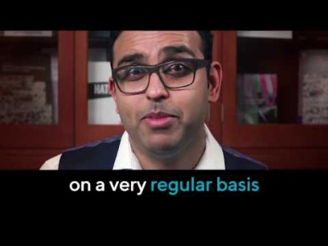
Peer-to-Peer Exercise:
STORYTELLING
How could faith-based organizations use their leverage, for example as advertisers, to “stop funding hate” in newspapers and other media?
Have you suffered any discrimination or hostility because of your religion or belief?
Notes:
This activity should be done with the whole group. Here, participants are encouraged to discuss their own personal experiences in upholding this commitment. It is useful for participants to see how these issues can be tackled in different ways.
Begin the discussion by playing this video: https://www.youtube.com/watch?v=-dG5DqqHgUI&t=5s
Now it is the participants’ turn to share their own stories on combating hate speech. Start asking the question that is on the slide:
Have you suffered any discrimination or hostility because of your religion or belief?
If so, how did you react to it?
Have religious or belief communities supported you through this hardship?

Slide 8

Peer-to-Peer Exercise:
ADDING FAITH QUOTES
"Whatever words we utter should be chosen with care for people will hear them and be influenced by them for good or ill."
(Buddha)
Think of quotes from your own religion or belief systems that support this commitment.
Notes:
Adding faith quotes (15 minutes)
Distribute the related Handout.
We recommend dividing the participants into small groups (ca. 4-5 people) so everyone can feel safe contributing to the discussion.
Ask participants to think about their own religious or non-religious traditions and whether they are aware of any quotes that they are aware of that are related to the commitment in question.
Start with the quote provided in the slide: "Whatever words we utter should be chosen with care for people will hear them and be influenced by them for good or ill." (Buddha)
Other quotes that can be referred to are:
"Repay injury with justice and kindness with kindness." (Confucius)
"What is hateful to you, don't do to your friend." (Talmud, Shabat, 31, a)
"Therefore all things whatsoever ye would that men should do to you, do ye even so to them: for this is the law and the prophets." (Matthew 7:12)
"Ascribe not to any soul that which thou wouldst not have ascribed to thee, and say not that which thou doest not." (Baha'u'llah)
Sharing with the larger group (5 minutes)
Ask participants from each group to share their quotes and briefly explain why they chose them.
Write down the quotes on a poster board or flip chart so everyone can see them.

Slide 9
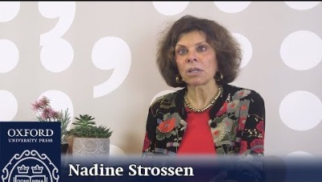
Peer-to-Peer Exercise:
Exploring
Notes:
This activity specifically explores the role of counter-speech. Religious and belief actors can address hate speech without necessarily using the law to do so.
First, watch the video from Nadine Strossen on counter-speech on slide 9. Remember to use the closed captions tools for better accessibility: https://www.youtube.com/watch?v=GsC6rLGSRm8

Slide 10
Peer-to-Peer Exercise:
Exploring
  “War starts in the minds and is cultivated by a reasoning fuelled by often hidden advocacy of hatred. Positive speech is also the healing tool of reconciliation and peace-building in the hearts and minds.”
  The Beirut Declaration
Notes:
Step-by-Step Instructions (PPT slide 12)
Supply each participant with a print of the Handout – Rabat Summary.
Distribute the Handout – Threshold Scenario to the participants.
Present the questions in the handout to the participants.
Participants should be encouraged to consider the multi-faceted aspects of speech and to carefully word their speech to minimize misunderstanding.
In addition, they should consider how to respond to the speech of others to avoid incitement.
Scenario: "Christian Pastor in Sierra Leone Blames Muslims"
A popular Nigerian Christian pastor was arrested in Sierra Leone for a sermon that incited hatred for Muslims. The pastor told his large Evangelical congregation that Islam is "a violent religion of lies and deceit" and claimed that Muslims are responsible for "every terrorist act in the history of the world."
Video recordings of his sermon were posted online and quickly went viral. Both Muslim and Christian communities in Sierra Leone condemned the pastor's comments. The head of Sierra Leone's criminal investigations department replied that citizens of Sierra Leone are tolerant of other religions and live peaceably. "No one wants that disrupted," he explained.
Although Sierra Leone has no specific anti-hate speech laws, incitement is prohibited under the common law. During the investigations, all six branches of the pastor's church were shut down. A director of a local civil rights group spoke out, claiming that a person's right to worship should not be limited and that the government should not shut down the church just because of hateful comments made by one person.
A Muslim member of an inter-faith council urged his followers to forgive the pastor and extend peace to their Christian neighbors. Some people on social media have demanded that the pastor apologize while others have insisted he be deported back to Nigeria.
(iv) Questions:
How should situations of "borderline hate speech" be addressed?
What "counter-speech" can faith actors produce and promote based on faith traditions?
What obstacles may limit the role of faith actors in countering hate speech?
What risks are involved in facing these situations, and how could these risks be mitigated?
How should faith leaders react when facing a situation of incitement to hatred?
Do public authorities welcome civil society or faith-based initiatives in this respect?

Slide 11

Peer-to-Peer Exercise:
Threshold Test
Notes:
Overview
This activity is taken from the BYU/ICLRS website dedicated to the Faith for Rights Framework. They have several excellent exercises that can be added to the training.
Participants analyze the multi-faceted effects of speech by using a six-part Threshold Test. This dynamic exercise allows participants to identify speech elements to avoid incitement to anger in future situations.
The goal of this activity is for participants to identify and apply the elements of the Threshold Test.

Slide 12
Peer-to-Peer Exercise:
Threshold Test
Notes:
Step-by-Step Instructions
Supply each participant with a print of the Handout – Rabat Summary.
Distribute the Handout – Threshold Scenario to the participants.
Present the questions in the handout to the participants.
Participants should be encouraged to consider the multi-faceted aspects of speech and to carefully word their speech to minimize misunderstanding.
In addition, they should consider how to respond to the speech of others to avoid incitement.
Scenario: "Christian Pastor in Sierra Leone Blames Muslims"
A popular Nigerian Christian pastor was arrested in Sierra Leone for a sermon that incited hatred for Muslims. The pastor told his large Evangelical congregation that Islam is "a violent religion of lies and deceit" and claimed that Muslims are responsible for "every terrorist act in the history of the world."
Video recordings of his sermon were posted online and quickly went viral. Both Muslim and Christian communities in Sierra Leone condemned the pastor's comments. The head of Sierra Leone's criminal investigations department replied that citizens of Sierra Leone are tolerant of other religions and live peaceably. "No one wants that disrupted," he explained.
Although Sierra Leone has no specific anti-hate speech laws, incitement is prohibited under the common law. During the investigations, all six branches of the pastor's church were shut down. A director of a local civil rights group spoke out, claiming that a person's right to worship should not be limited and that the government should not shut down the church just because of hateful comments made by one person.
A Muslim member of an inter-faith council urged his followers to forgive the pastor and extend peace to their Christian neighbors. Some people on social media have demanded that the pastor apologize while others have insisted he be deported back to Nigeria.
Questions:
How should situations of "borderline hate speech" be addressed?
What "counter-speech" can faith actors produce and promote based on faith traditions?
What obstacles may limit the role of faith actors in countering hate speech?
What risks are involved in facing these situations, and how could these risks be mitigated?
How should faith leaders react when facing a situation of incitement to hatred?
Do public authorities welcome civil society or faith-based initiatives in this respect?

