Slide 1
Module 6 of the #Faith4Rights toolkit
Minority Rights
Notes:
Facilitator Notes:
This session uses the #Faith4Rights toolkit, specifically module 6.
This peer-to-peer learning module emphasizes discussion and participant interaction. The specific module, module 6, focuses on the rights of minorities and the discrimination they might face.

Slide 2
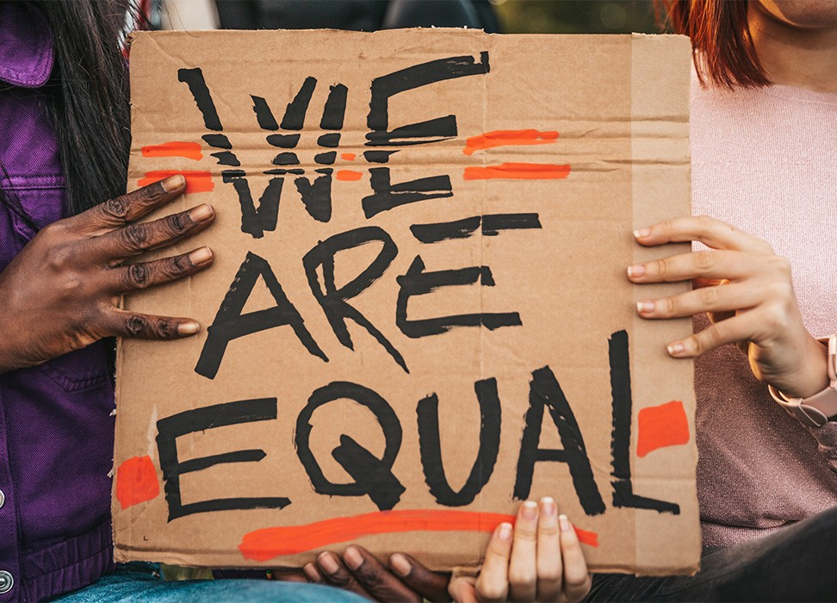
Commitment VI
“We pledge to stand up for the rights of all persons belonging to minorities within our respective areas of action and to defend their freedom of religion or belief as well as their right to participate equally and effectively in cultural, religious, social, economic and public life, as recognized by international human rights law, as a minimum standard of solidarity among all believers.”
Notes:
Refer the participants to the full commitment, and read it out. The point of this slide is to provide background to the participants and provide an anchor for the discussions in this session.
Reading aloud the commitment at the outset ensures that all participants focus their minds on it. Emphasize the need to" stand up" and take an active approach to opposing discrimination against minorities. Religious leaders have a role to play in ensuring minorities are heard and defended in their own communities.
The key takeaway is that in a world of increasing polarization, faith actors can harness their position to advocate for minority rights.

Slide 3
Peer-to-Peer Exercise:
TRANSLATING COMMITMENT VI
  “Translate” this commitment into the simplest manner possible while keeping the core message intact. You can also translate it to another language or dialect if you prefer.
Notes:
"Translate" this commitment in the simplest manner possible while keeping the core message intact. You can also translate it into another language or dialect if you prefer.
This will help stimulate discussion about the most relevant parts of the commitment and how this can be communicated with the wider public.
This activity can be done individually.

Slide 4
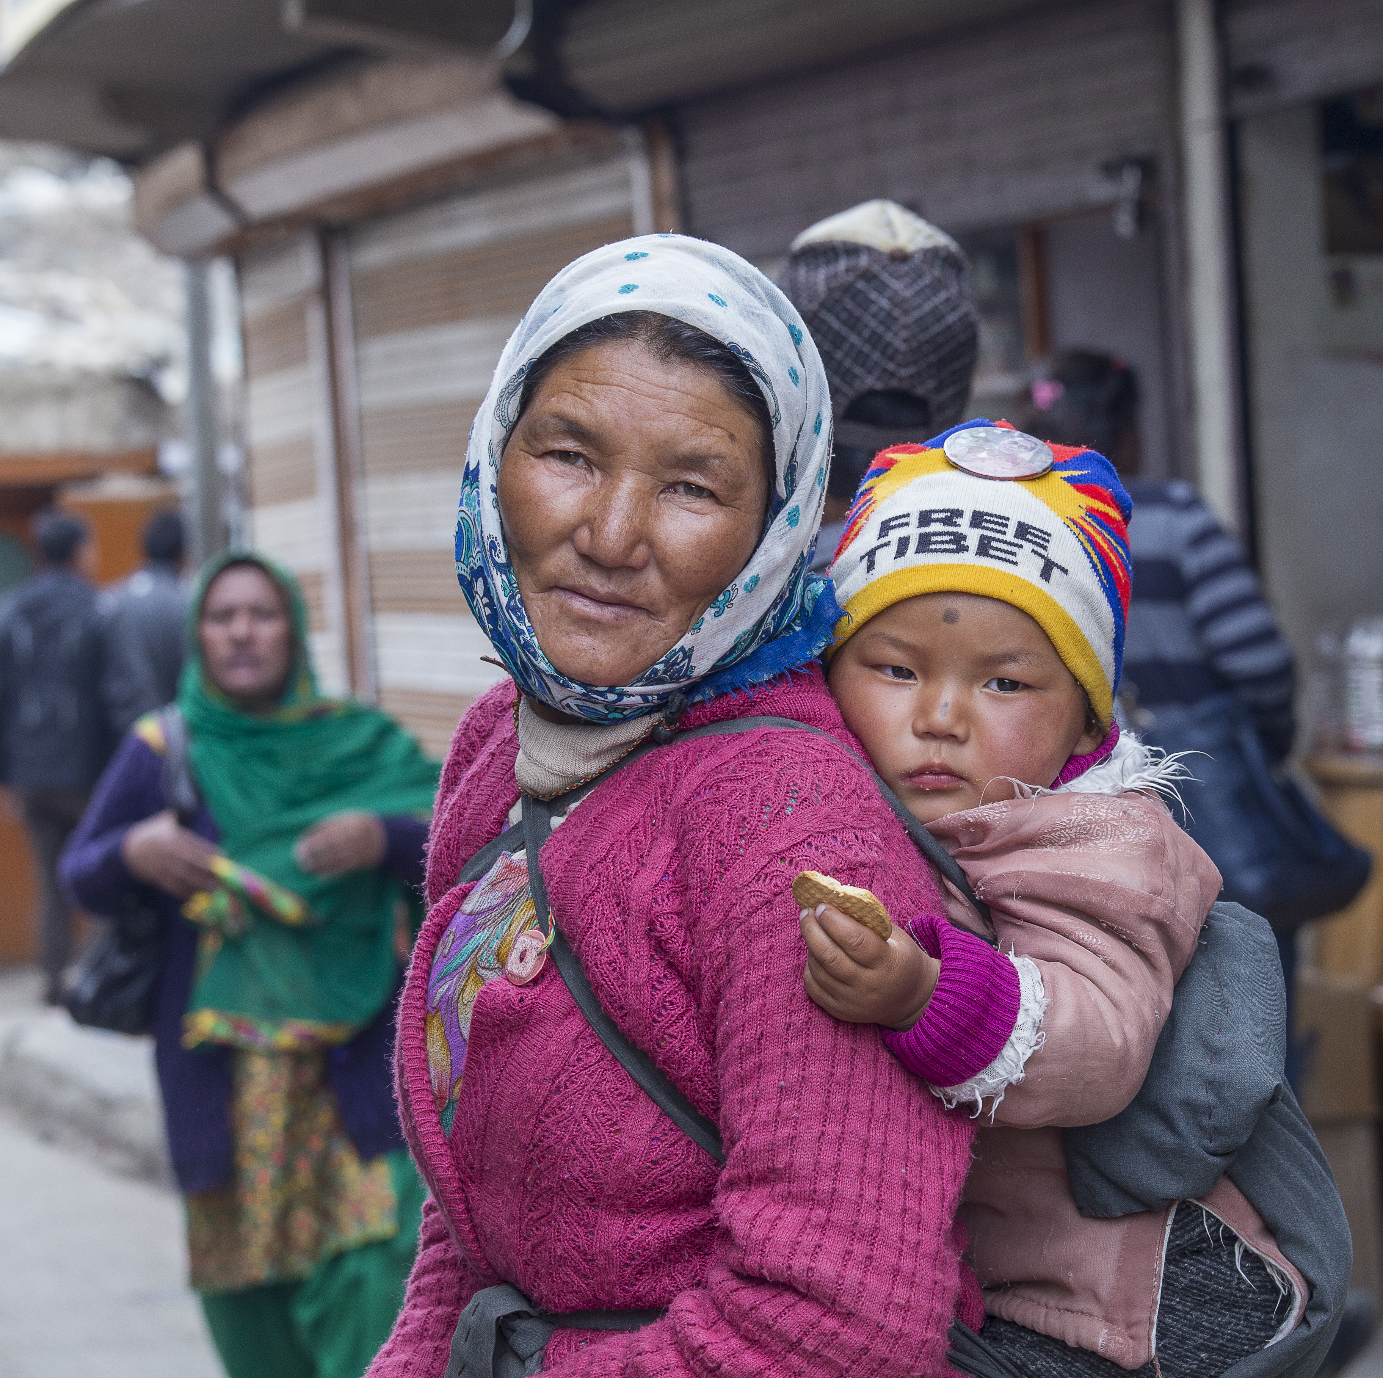
Module 6 of the #Faith4Rights toolkit and Article 27 of the International Covenant on Civil and Political Rights
  “In those States in which ethnic, religious or linguistic minorities exist, persons belonging to such minorities shall not be denied the right, in community with other members of their group, to enjoy their own culture, to profess and practice their own religion, or to use their own language.”
Notes:
Similar to the right to freedom of religion or belief explored in the Introduction Part 3, the obligation of States to protect persons belonging to minorities is included in the International Covenant on Civil and Political Rights (ICCPR). As mentioned in that session, the ICCPR is a legally binding document for States that have accepted (ratified) this treaty.
Read the right out in full. Ask participants if they find the right fit for purpose or if there is something missing from it. Does it lack any protection? What else could it protect?

Slide 5
What is the definition of 'minority'?
  “An ethnic, religious or linguistic minority is any group of persons which constitutes less than half of the population in the entire territory of a State whose members share common characteristics of culture, religion or language, or a combination of any of these. A person can freely belong to an ethnic, religious or linguistic minority without any requirement of citizenship, residence, official recognition or any other status. ”
  Fernand de Varennes, Report of the Special Rapporteur on Minority Issues, 2019, paragraph 53
Notes:
This module from the #F4R toolkit builds on the idea of a minority, but it is important to recognize that this concept may be contentious. This slide invites a discussion on the term and its consequences. This may take up to 25 minutes.
There is no universally accepted definition of minority in international law, and the above quote is a suggested working definition from Special Rapporteur Fernand de Varennes's 2019 report on the concept of a minority (https://undocs.org/A/74/160). Invite participants to share their thoughts on this definition.
Ask participants if they find the definition fit for purpose, or if there is something missing from it.
If the participants do not have much to share, include a counterpoint to this definition. This can be found in the Document on Human Fraternity for World Peace and Living Together, a joint statement released by Pope Francis and the Grand Imam of Al-Azhar, Ahmed el-Tayeb in 2019, both dignitaries reject the "the discriminatory use of the term minorities which engenders feelings of isolation and inferiority" Invite the participants to share their thoughts.
A useful conclusion may be that whilst the choice of words is important, it should not restrict a conversation. The 2019 working definition may be the most helpful way to examine minority rights as we understand them today.

Slide 6
Module 6: Challenges
Human rights violations that minorities face “include […] systematic discrimination and partial exclusion from important sectors of society; […] indoctrination of children from minorities in public schools; publicly stoked prejudices and vilification sometimes connected with historic traumas and national mythologies […] ”
Notes:
This slide examines some of the difficulties that minorities face, as laid out in the 2012 report of the Special Rapporteur on freedom of religion or belief.
Ask the group what are some general forms of discrimination that minorities suffer that they are aware of. This is a short brainstorming exercise, as in the next section, participants will be called to share their own experiences on the subject.

Slide 7
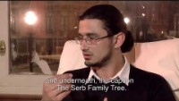
Peer-to-Peer Exercise:
Peer-to-Peer Exercise:
STORYTELLING
STORYTELLING
Notes:
Video – Standing up for minority rights (5 minutes)
This exercise, taken from the #Faith4Rights toolkit in Module 6, starts with a video, "Standing up for minority rights", featuring a meeting of ten Serbs and ten Croats in Brussels during Holy Week 2017: https://www.youtube.com/watch?v=oocbRyThld0&t=114s
This video highlights minorities discussing the barriers they face. One of the participants, Jelena, noted the following: "What made me especially happy is the fact that our groups got along very well. The rule of the pair-work sessions forced us into simple conversations, and the results were very good."

Slide 8
Peer-to-Peer Exercise:
Peer-to-Peer Exercise:
STORYTELLING
Share your story
    What types of minorities are there in your communities?
  What type of discrimination do they face?
  How has your religious community/belief group addressed this discrimination?
STORYTELLING
Notes:
(ii) Share your story (15 minutes)
Spend the rest of the time allotted for this activity discussing the video with the whole group. Ask if anyone has a similar story to share.
Other questions for discussion can be the following:
What types of minorities are there in your communities?
What type of discrimination do they face?
How your religious community/belief group has addressed this discrimination?

Slide 9
Peer-to-Peer Exercise:
UNPACKING
  Why is this commitment important?
  What are the different components of the commitment?
  What are the corresponding action points to these components?
  Who are the stakeholders that would take those actions?
Notes:
This activity consists of three parts, with the first being individual reflections for 5 minutes, the second discussing those individual reflections in a small group for 10 minutes, and the third sharing the perspectives with the larger group for 5 minutes.
The four questions on the handout focus on listing the elements, action points and stakeholders.
The key takeaway is to recognize the complexity of these issues whilst seeking to move forward with the commitment.
Further resources and explanations on this activity can be found in this link to the BYU/ICLRS website. This is a great site that can be used to build training events with different activities.

Slide 10
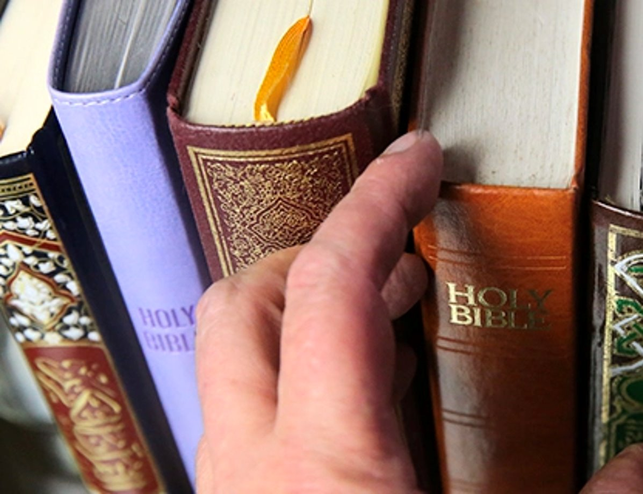
Peer-to-Peer Exercise:
ADDING FAITH QUOTES
“Be a lamp, or a lifeboat, or a ladder. Help someone’s soul heal. Walk out of your house like a shepherd” (Rumi)
Think of quotes from your own religion or belief systems that support this commitment. Discuss in your small groups, and report back in 15 minutes.
Notes:
Adding faith quotes (15 minutes)
Distribute the related Handout.
We recommend dividing the participants into small groups (ca. 4-5 people) so everyone can feel safe contributing to the discussion.
Ask participants to think about their own religious or non-religious traditions and whether they are aware of any quotes that they are aware of that are related to the commitment in question.
Start with the quote provided in the slide: "Be a lamp, or a lifeboat, or a ladder. Help someone's soul heal. Walk out of your house like a shepherd" (Rumi)
Other quotes that can be referred to are:
"Someone who saves a person's life is equal to someone who saves the life of all." (Qu'ran 5:32)
"Your true character is most accurately measured by how you treat those who can do 'Nothing' for you. (Mother Teresa)
"Whoever preserves one life, is considered by Scripture as if one has preserved the whole world." (Talmud, Sanhedrin, 37, a).
"You shall love the Lord your God with all your heart, all your soul, all your strength, and with your entire mind; and your neighbour as yourself." (Luke 10:27)
"Let us stand together, make statements collectively and may our thoughts be one." (Rigveda 10:191:2)
"Just as I protect myself from unpleasant things however small, in the same way I should act towards others with a compassionate and caring mind." (Shantideva, A Guide to the Bodhisattva's Way of Life)
"Ye are the fruits of one tree, and the leaves of one branch." (Bahá'u'lláh)
Sharing with the larger group (5 minutes)
Ask participants from each group to share their quotes and briefly explain why they chose them.
Write down the quotes on a poster board or flip chart so everyone can see them.

Slide 11
Peer-to-Peer Exercise:
EXPLORING
What role does religion play in this context?
How can minority discrimination be addressed through religion?
How can faith actors contribute to fighting discrimination?
Notes:
This activity should be done in small groups of 4-5 and should take around 20 minutes. Here participants are invited to focus specifically on what their role might be in protecting minority rights.
Participants may find it useful to draw up a stakeholder map regarding different religious communities in their society and discuss the role and responsibilities of each stakeholder, including themselves.
This discussion and activity may be guided by the questions on the slide.

