Slide 1
Module 5 of the #Faith4Rights toolkit
Women, girls and gender equality
Notes:
Facilitator Notes:
This session uses the #Faith4Rights toolkit, specifically module 5. This peer-to-peer learning module emphasizes discussion and participant interaction.
This module focuses on women's rights, the treatment of girls, and gender equality.

Slide 2
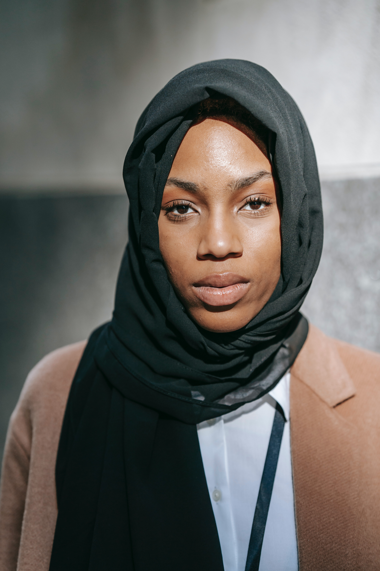
Commitment V
We pledge to ensure non-discrimination and gender equality in implementing this declaration on “Faith for Rights.” We specifically commit to revisit, each within our respective areas of competence, those religious understandings and interpretations that appear to perpetuate gender inequality and harmful stereotypes or even condone gender-based violence. […]
Notes:
Refer participants to the full commitment and read it out. The point of this slide is to provide background to the participants and provide an anchor for the discussions in this session.
Reading aloud the commitment at the outset ensures that all participants focus their minds on it. Take the first 5 minutes of the session to read the commitment and emphasize the role that religious leaders have in combatting harmful religious understandings of women's rights.
The key takeaway from this module is that religious leaders have a role in tackling religious understanding and interpretations that allow for an imbalance between the genders, particularly in the form of discrimination and violence.

Slide 3
Commitment V
[…] We pledge to ensure justice and equal worth of everyone as well as to affirm the right of all women, girls and boys not to be subjected to any form of discrimination and violence, including harmful practices such as female genital mutilation, child and/or forced marriages and crimes committed in the name of so-called honor.
Faith for Rights Commitment V
Notes:
Refer participants to the full commitment and read it out. The point of this slide is to provide background to the participants and provide an anchor for the discussions in this session.
Reading aloud the commitment at the outset ensures that all participants focus their minds on it. Take the first 5 minutes of the session to read the commitment and emphasize the role that religious leaders have in combatting harmful religious understandings of women's rights.
The key takeaway from this module is that religious leaders have a role in tackling religious understanding and interpretations that allow for an imbalance between the genders, particularly in the form of discrimination and violence.

Slide 4
Peer-to-Peer Exercise:
TWEETING COMMITMENT V
  Summarise this commitment in less than 140 characters and decide how to articulate Commitment V in your own words.
Notes:
Once the whole commitment has been read out, with the emphasis on the key terms in it, take 10 minutes to take on the Tweeting exercise, which is found in the peer-to-peer learning exercises in module 5.
This exercise is intended to de-construct and re-construct the commitment to reenergize the discussions.
It may be useful to frame the question in terms such as, "how can the main points of this commitment be put simply, in a clear and concise way that people in your community would understand?". This can be done with small groups of 3-4.
One possible result of this tweeting exercise could be as follows: "We commit to ensure non-discrimination and gender equality, particularly regarding harmful stereotypes and practices or gender-based violence".

Slide 5
Module 5 and Articles 1 and 2 of the Universal Declaration of Human Rights
Article 1
All human beings are born free and equal in dignity and rights. […]
  Article 2
  Everyone is entitled to all the rights and freedoms set forth in this Declaration, without distinction of any kind, such as race, colour, sex, language, religion, political or other opinion, national or social origin, property, birth or other status.
Notes:
This module from the #F4R toolkit builds on the right in Article 2 of the Universal Declaration of Human Rights. Almost all human rights treaties prohibit gender-based discrimination. Despite being fundamental to human rights, gender equality has not been realized equally in all countries. Part of this can be attributed to patriarchal interpretations of almost all religions.
Read Articles 1 and 2 of the UDHR on the slide.
In the next few slides, take some time to examine the human rights linked to this commitment. It would be useful to make those links explicit to the participants about how the content of the slides relates to the commitment to non-discrimination and gender equality.
On this slide, emphasize how gender equality was made part of international human rights law by the Universal Declaration of Human Rights recognizing that "All human beings are born free and equal in dignity and rights", stressing that the UDHR is referring to "all" beings – not just men.

Slide 6

Module 5 and Sustainable Development Goal 5
“Achieve gender equality and empower all women and girls”
Notes:
Slide 6 looks at Sustainable Development Goal 5 (SDG 5), which is focused on gender equality. The SDGs are 17 goals adopted by all UN member States that seek to provide for a better future. They are an urgent call for action by all countries seeking to end poverty and reduce inequality. The next slide provides some statistics and facts that should be discussed and unpacked.

Slide 7
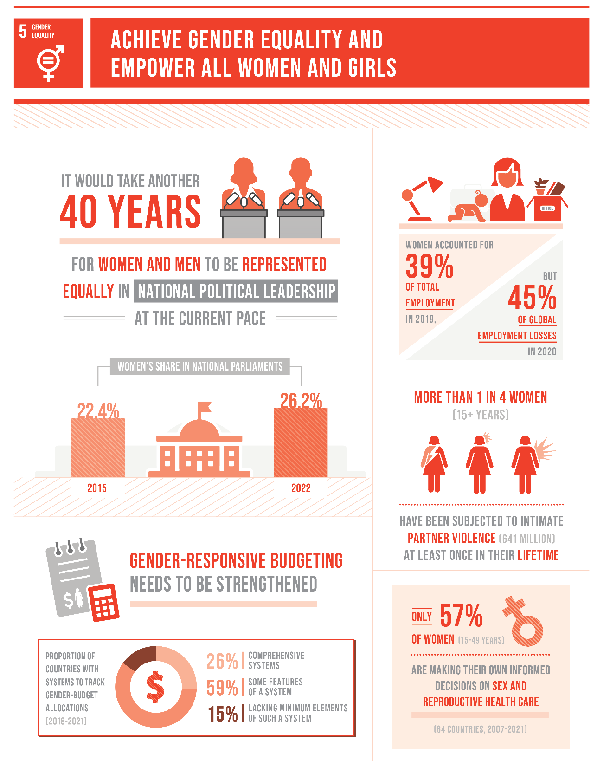
Module 5 and Sustainable Development Goal 5
“Achieve gender equality and empower all women and girls”
Notes:
Slide 7 looks at the Sustainable Development Goal 5 (SDG 5), which is focused on gender equality. This info-graphic comes from the Sustainable Goals Development Report 2022, and provides some sobering facts and figures on the gender imbalance that exists today.
Spend some time discussing each of these facts with participants. Ask participants to pick out ones that resonate with them, and examine which ones have the most relevance to Commitment 5.

Slide 8
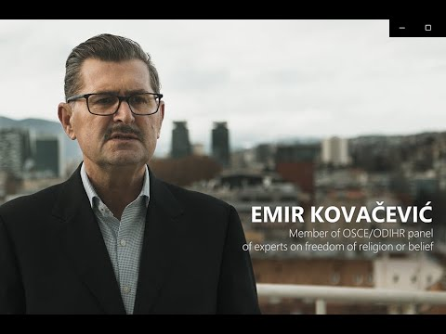
Notes:
This video provides good insight into some of the issues specific to women regarding freedom of religion or belief. Play the video and allow participants to comment briefly: https://www.youtube.com/watch?v=6NYpThtt_BY
When playing the video, please ensure that the YouTube settings allow closed captions for accessibility.

Slide 9
Module 5 and General Recommendation No. 31 of the Committee on the Elimination of Discrimination against Women
  “One of the primary challenges in the elimination of harmful practices relates to the lack of awareness or capacity of relevant professionals, […], to adequately understand, identify and respond to incidents or the risks of harmful practices. A comprehensive, holistic and effective approach to capacity-building should aim to engage influential leaders, such as traditional and religious leaders”.
Notes:
The general recommendation from the Committee on the Elimination of Discrimination against Women (CEDAW) emphasizes the role that religious leaders have in forwarding the fundamental goal of gender equality. The Committee also recognize that a major obstacle to this is the lack of awareness of relevant professionals. Module 5 seeks to change that; it seeks to empower religious leaders to think critically about their role and what they can do to forward gender equality.
The Committee on the Elimination of Discrimination against Women (CEDAW) are a body of independent experts that monitor how the Convention on the Elimination of All Forms of Discrimination against Women is being implemented. This Convention is fundamental to gender equality and the rights of women and girls. It is often described as an International Bill of Rights for Women. Spend 10 minutes on this slide and the next, discussing and unpacking the quotes. On this slide, ask the participants to highlight any areas concerning gender equality where they may lack awareness.

Slide 10
Peer-to-Peer Exercise:
LINKING THE DOTS
  Explore each right of the Universal Declaration of Human Rights.
  What is the importance of these rights to women and girls?
  Which ones are fully respected in your religious/belief tradition?
  Which ones are not always respected in your religious/belief tradition?
  Why do women and girls suffer discrimination under most religious traditions?
  What are the origins of this phenomena?
  What is the responsibility of religious leaders in this regard?
Notes:
Provide participants with the UDHR handout (Module 5 - handout – Linking the dots) and ask them to go through each article that is not fully respected or raise difficulties for women because of perceptions and practices from participants' own religious backgrounds.
Split the group into smaller groups of 3-4, to allow them to discuss these questions for 15 minutes. Spend 5 minutes with the whole group, to hear what each group had discussed.
This exercise, taken from the #Faith4Rights toolkit, does not attempt to raise and resolve all the issues in relation to gender inequality; it merely seeks to indicate the complexity and interconnectedness of all the issues. This is a highly recommended activity as it gives participants the opportunity to unpack the commitment and address it in their own communities. However, the Facilitator should emphasize the need to focus on a limited discussion to prevent derailing into a wider discussion around related subjects.
Further resources and explanations on this activity can be found in this link to the BYU/ICLRS website.

Slide 11
Peer-to-Peer Exercise:
CRITICAL THINKING
Do you disagree with some or all of the elements in Commitment V?
Are there missing elements in Commitment V that could improve our fight against gender discrimination?
Are there women religious leaders in your environment? Why not?
What are the obstacles of having more women with responsibilities within the religious sphere?
Notes:
In this activity, participants brainstorm in small groups of 4-5 on the commitment and then discuss it widely with the group. The smaller group discussions should take 15 minutes, with 5 minutes left to discuss with the group.
The purpose of this activity is to discuss the commitment more deeply, hoping to encourage action-focused thinking. This will hopefully allow participants to look at foreseeable and achievable change, which they can be a part of.
Some questions are available in the slide to promote the discussion of the topic.

Slide 12
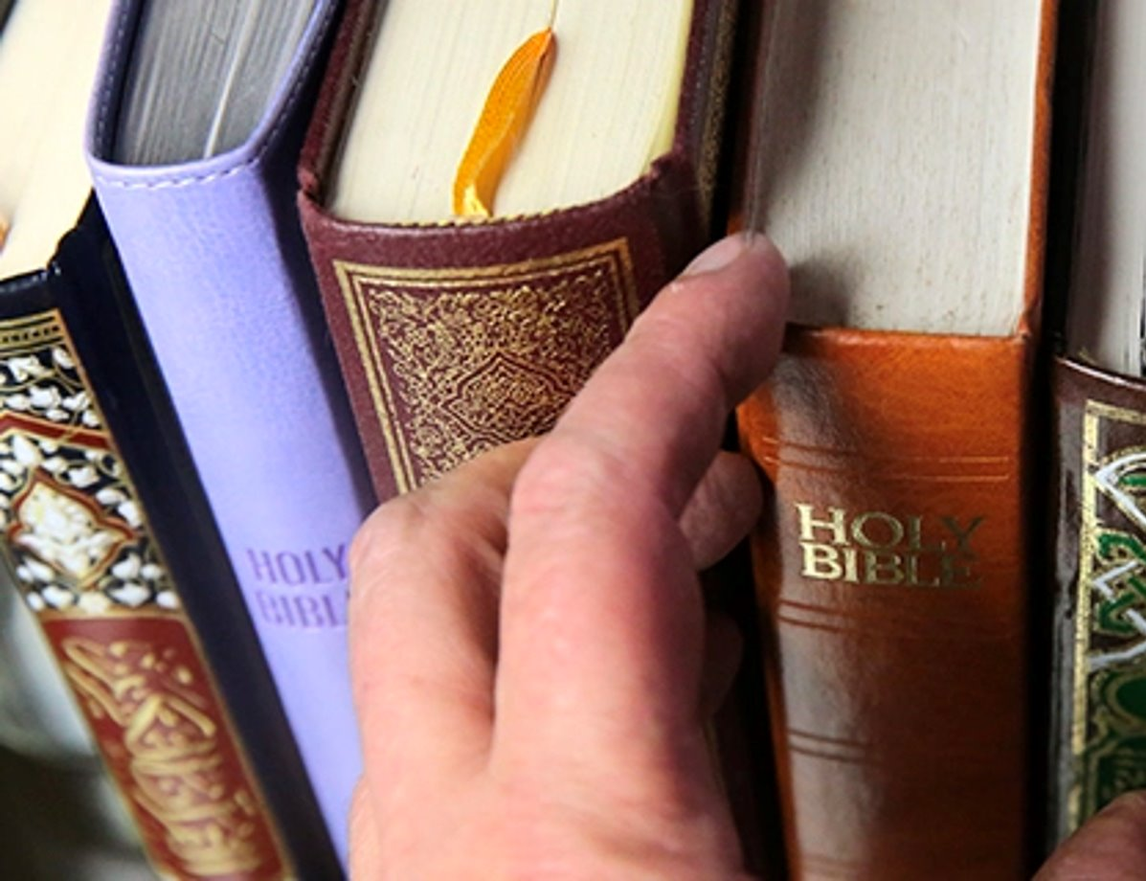
Peer-to-Peer Exercise:
ADDING FAITH QUOTES
"The world of humanity is possessed of two wings - the male and the female. So long as these two wings are not equivalent in strength the bird will not fly. Until womankind reaches the same degree as man, until she enjoys the same arena of activity, extraordinary attainment for humanity will not be realized"
('Abdu'l-Baha)
Think of quotes from your own religion or belief systems that support this commitment.
Notes:
(i) Adding faith quotes (15 minutes)
Distribute the related Handout.
We recommend dividing the participants into small groups (ca. 4-5 people) so everyone can feel safe contributing to the discussion.
Ask participants to think about their own religious or non-religious traditions and whether they are aware of any quotes that they are aware of that are related to the commitment in question.
Start with the quote provided in the slide: "The world of humanity is possessed of two wings - the male and the female. So long as these two wings are not equivalent in strength the bird will not fly. Until womankind reaches the same degree as man, until she enjoys the same arena of activity, extraordinary attainment for humanity will not be realized" ('Abdu'l-Baha)
Other quotes that can be referred to are:
"A man should respect his wife more than he respects himself and love her as much as he loves himself." (Talmud, Yebamot, 62,b)
"Never will I allow to be lost the work of anyone among you, whether male or female; for you are of one another." (Qur'an 3, 195)
"In the image of God He created him male and female. He created them." (Genesis 1, 27)
"It is a woman who is a friend and partner for life. It is woman who keeps the race going. How may we think low of her of whom are born the greatest? From a woman a woman is born: none may exist without a woman." (Guru Granth Sahib, p. 473)
(ii) Sharing with the larger group (5 minutes)
Ask participants from each group to share their quotes and briefly explain why they chose them.
Write down the quotes on a poster board or flip chart so everyone can see them.

Slide 13
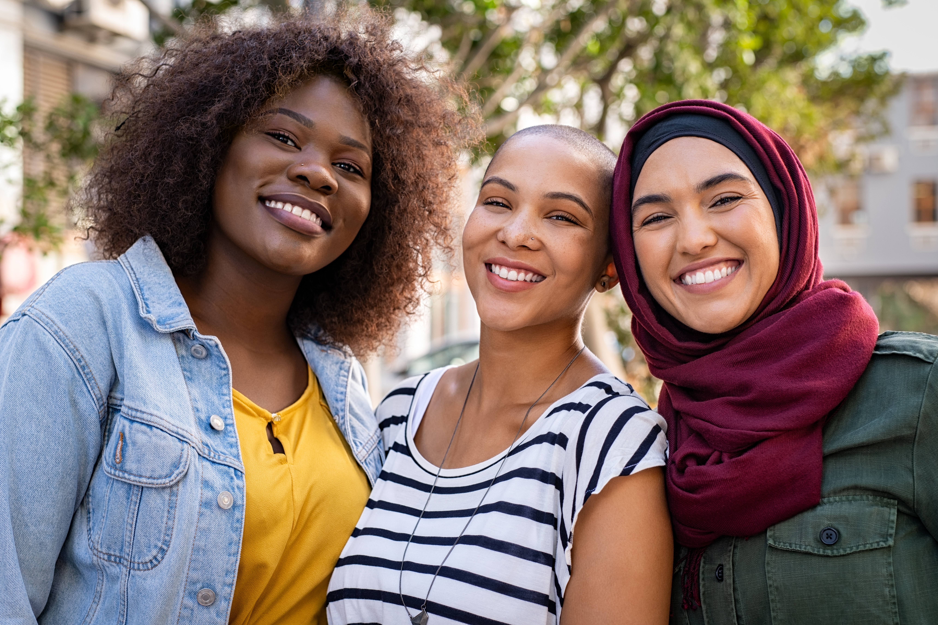
Peer-to-Peer Exercise:
STORYTELLING
Has there been a time where you have had to intervene in defence of the rights of women or girls?
What did you do?
Notes:
This activity should be done with the whole group and should take around 20 minutes. Here, participants are encouraged to discuss their own personal experiences in upholding this commitment. It is useful for participants to see how these issues can be tackled in different ways.
Facilitators should encourage participants to lead on this and build on each other's stories, but it may be helpful to guide them with questions such as: "Has there been a time where you have had to intervene in defence of the rights of women or girls?" Further questions can include:
What type of discriminatory practices are more likely to occur in the experience of participants?
How can religious actors do better to ensure gender equality?"

