Slide 1
Module 4 of the #Faith4Rights toolkit
Religious or Belief pluralism
Notes:
Facilitator Notes:
This session uses the #Faith4Rights toolkit, specifically module 4. This peer-to-peer learning module emphasizes discussion and participant interaction.
This module focuses on state religion which can lead to discrimination against religious minorities. It looks closely at the relationship between States and religious institutions.

Slide 2
Commitment IV
“We pledge to support and promote equal treatment in all areas and manifestations of religion or belief and to denounce all forms of discriminatory practices. We commit to prevent the use of the notion of ’State religion’ to discriminate against any individual or group and we consider any such interpretation as contrary to the oneness of humanity and equal dignity of humankind. Similarly, we commit to prevent the use of ‘doctrinal secularism’ from reducing the space for religious or belief pluralism in practice.”
Notes:
Refer participants to the full commitment, and read it out. The point of this slide is to provide background to the participants and provide an anchor for the discussions in this session.
Reading aloud the commitment at the outset ensures that all participants focus their minds on it. Take the first 5 minutes of the session to read the commitment, and emphasize the role that religious leaders have in ensuring religion is not used as a tool to discriminate. The key takeaway from this module is that neutrality is necessary for inclusion, equality and freedom for all and that religious leaders need to be part of this.

Slide 3
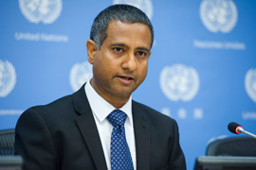
Former Special Rapporteur Ahmed Shaheed
“States must satisfy a range of obligations, including to adopt measures that guarantee structural equality and to fully realize freedom of religion or belief.”
Notes:
This quote from the former Special Rapporteur is a good analysis of the relationships between State and religion and their impact on freedom of religion or belief. Spend 5 minutes discussing the quotes from Ahmed Shaheed's report, the Special Rapporteur on freedom of religion or belief at the time, on this (https://undocs.org/A/HRC/37/49, paras. 29 and 89). Emphasize the importance of respectful distancing, which seeks to establish that religion and politics should be separated if inclusion, equality and freedom for all are to be achieved.

Slide 4
Former Special Rapporteur Ahmed Shaheed
“In the light of these obligations, the Special Rapporteur echoes the importance of adopting a model for the relationship between State and religion that is in harmony with the concept of ‘respectful distancing’ — i.e. political and legal, but not social, disentanglement from religion — which rests on a ‘deep grounding of secularity based on human rights’.”
Notes:
This quote from the former Special Rapporteur is a good analysis of the relationships between State and religion and their impact on freedom of religion or belief. Spend 5 minutes discussing the quotes from Ahmed Shaheed's report, the Special Rapporteur on freedom of religion or belief at the time, on this (https://undocs.org/A/HRC/37/49, paras. 29 and 89). Emphasize the importance of respectful distancing, which seeks to establish that religion and politics should be separated if inclusion, equality and freedom for all are to be achieved.

Slide 5
Former Special Rapporteur Ahmed Shaheed
“Such a model ensures ‘that the State does not resort to religious exclusivity or bias in culture, identity, schooling, or even symbolism for short-term ends and for vested interests, but will continually strive to create spaces of inclusiveness for all as an active and ongoing endeavour.'"
Report of the Special Rapporteur on freedom of religion and belief, 2018
Notes:
This quote from the former Special Rapporteur is a good analysis of the relationships between State and religion and their impact on freedom of religion or belief. Spend 5 minutes discussing the quotes from Ahmed Shaheed's report, the Special Rapporteur on freedom of religion or belief at the time, on this (https://undocs.org/A/HRC/37/49, paras. 29 and 89). Emphasize the importance of respectful distancing, which seeks to establish that religion and politics should be separated if inclusion, equality and freedom for all are to be achieved.

Slide 6
Peer-to-Peer Exercise:
TWEETING COMMITMENT IV
  Summarise this commitment in less than 140 characters and decide how to articulate Commitment IV in your own words.
Notes:
Once the whole commitment and quote from the Special Rapporteur have been read out, with the emphasis on the key terms in them, take 10 minutes for a Tweeting exercise, which is found in the peer-to-peer learning exercises in module 4.
It may be useful to frame the question in terms such as "how can the main points of this commitment be put simply, in a clear and concise way that people in your community would understand?". This can be done with small groups of 3-4.
This part of the exercise is intended to de-construct and re-construct the commitment to reenergise the discussions.
One possible result of this tweeting exercise could be as follows: “We commit to prevent the notions of ‘State religion’ and ‘doctrinal secularism’ from being used to discriminate or reduce the space for diversity of religions and beliefs”.

Slide 7
Peer-to-Peer Exercise:
UNPACKING COMMITMENT IV
  Why is this commitment important?
  What are the different components of the commitment?
  What are the corresponding action points to these components?
  Who are the stakeholders that would take those actions?
Notes:
This activity consists of three parts, with the first being individual reflections for 5 minutes, the second discussing those individual reflections in a small group for 10 minutes, and the third sharing the perspectives with the larger group for 5 minutes.
The four questions on the handout focus on listing the elements, action points and who might take those action points on.
This exercise, taken from the #Faith4Rights toolkit, does not attempt to raise and resolve all the issues in relation to secularism; it merely seeks to indicate the complexity and interconnectedness of all the issues. This is a highly recommended activity as it gives participants the opportunity to unpack the commitment and address it specifically in their own community. However, the Facilitator should emphasize the need to focus on a limited discussion to prevent derailing into a wider discussion around too many related subjects.
Personal Reflection (PPT slide 7) (5 minutes)
In the first 5 minutes, participants should reflect on the three questions independently. They may use the template table provided in the Handout.
Small group discussion (10 minutes)
Split the group into smaller groups of 3-4, to allow all of them to discuss these questions.
Participants should spend 10 minutes discussing their personal reflections on those questions. The purpose of this is to allow participants to recognize that there are various readings of the same commitment. This diversity allows for different views on who holds what responsibilities, both at the state and non-state levels.
Sharing with the larger group (5 minutes)
Ask participants from each group to briefly share their thoughts.
Write down the ideas on a poster board or flip chart so everyone can see them.

Slide 8
Peer-to-Peer Exercise:
CRITICAL THINKING
Could you provide examples of denying equal treatment for all individuals and communities in manifesting their religions or beliefs from your home country?
Do you agree or disagree with the discriminatory risks embodied in the notions of “State religion” and “secularism”? Why or why not?
Do you believe that there are any elements missing in Commitment 4? What would you add and why?
Notes:
In this activity, participants brainstorm in small groups of 4-5 on the commitment and then discuss it widely with the group. The smaller group discussions should take 15 minutes, with 5 minutes left to discuss with the group.
The purpose of this activity is to discuss the commitment more deeply, hoping to encourage action-focused thinking. This will hopefully allow participants to look at foreseeable and achievable change, which they can be a part of.

Slide 9
Peer-to-Peer Exercise:
CONSTITUTION DRAFTING
Constitution of Brazil - Preamble
“We, the representatives of the Brazilian People […] promulgate, under the protection of God, this Constitution of the Federative Republic of Brazil.”
Constitution of Brazil – Article 19(1)
The union, the states, the federal district and the municipalities are forbidden to establish religious sects or churches, subsidize them, hinder their activities, or maintain relationships of dependence or alliance with them or their representatives, without prejudice to collaboration in the public interest in the manner set forth by law;
Devise your own provision that defines an ideal relationship between religion and state in the fictitious constitution.
Notes:
In this activity, participants brainstorm in small groups of 4-5 for 15 minutes to that devise their own provisions which define an ideal relationship between religion and state in the fictitious constitution, and then discuss their provisions with the whole group of participants for 5 minutes at the end.
Here, participants are asked to devise their own constitutional provision which deals with religion and secularism. This does not need to be in complex or sophisticated language. The group is provided with examples of constitutional provisions which deal with this matter.
NOTE: Because of the creative nature of this activity, you may want to increase the time provided for this activity. If this is the case, reduce the number of activities you plan to include in your training event accordingly.

Slide 10
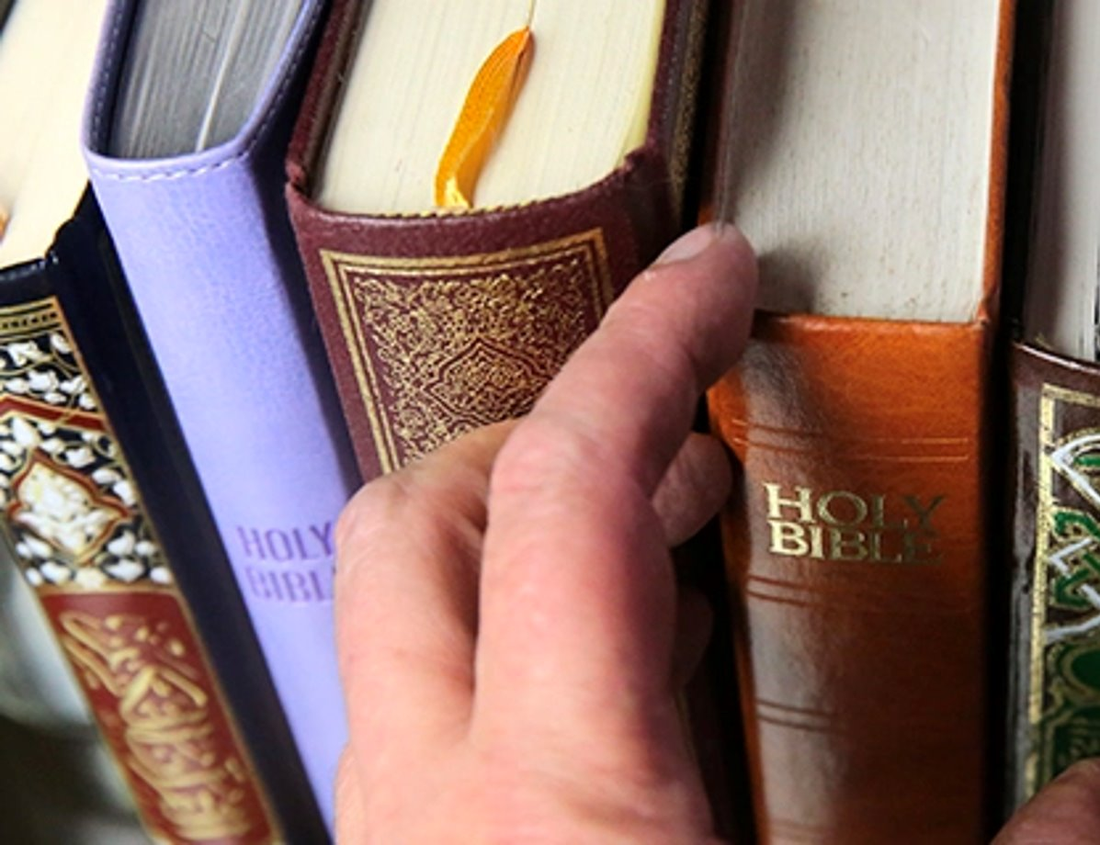
Peer-to-Peer Exercise:
ADDING FAITH QUOTES
“Then Peter began to speak: ‘I now realize how true it is that God does not show favoritism.’” (Acts 10:34)
Think of quotes from your own religion or belief systems that support this commitment. Discuss in your small groups, and report back in 15 minutes.
Notes:
Adding faith quotes (15 minutes)
Distribute the related Handout.
We recommend dividing the participants into small groups (ca. 4-5 people) so everyone can feel safe contributing to the discussion.
Ask participants to think about their own religious or non-religious traditions and whether they are aware of any quotes that they are aware of that are related to the commitment in question.
Start with the quote provided in the slide: "Then Peter began to speak: 'I now realize how true it is that God does not show favoritism." (Acts 10:34).
Sharing with the larger group (5 minutes)
Ask participants from each group to share their quotes and briefly explain why they chose them.
Write down the quotes on a poster board or flip chart so everyone can see them.

Slide 11
Peer-to-Peer Exercise:
STORYTELLING
"In 2004, a former bishop of the Macedonian Orthodox Church was sentenced by national courts to imprisonment for having instigated violence against himself and his followers because he had left the predominant Church and created a schism. An opinion by the Panel of Experts on Freedom of Religion and Belief of the Organization for Security and Cooperation in Europe's Office for Democratic Institutions and Human Rights expressed concerns about the judgment's approach, which seemed to suggest that any form of religious activity that effectively challenged the legitimacy and supremacy of the Macedonian Orthodox Church as the dominant religion should be considered an action that promotes religious hatred. […]
Notes:
This activity should be done with the whole group and should take around 20 minutes. Here, participants are encouraged to discuss their own personal experiences in upholding this commitment. It is useful for participants to see how these issues can be tackled in different ways.
Facilitators should encourage participants to lead on this and build on each other's stories, but it may be helpful to guide them with the example raised by the Special Rapporteur provided in the slides.

Slide 12
Peer-to-Peer Exercise:
STORYTELLING
[…] Since Bishop Jovan had been the target of a hostile response from opposing believers, it is astonishing that he was found by the first instance court to have instigated religious hatred 'towards himself and his followers'. Subsequently, the Supreme Court partially accepted his appeal with regard to the freedom to perform religious rites and reduced his prison sentence to eight months. "
2019 Report of the Special rapporteur on Freedom of Religion or Belief
What experiences have you had with discrimination involving "State religion" and "secularism"?
Notes:
This activity should be done with the whole group and should take around 20 minutes. Here, participants are encouraged to discuss their own personal experiences in upholding this commitment. It is useful for participants to see how these issues can be tackled in different ways.
Facilitators should encourage participants to lead on this and build on each other's stories, but it may be helpful to guide them with the example raised by the Special Rapporteur provided in the slides.

