Slide 1
Module 16 of the #Faith4Rights toolkit
Ethical and Spiritual leverage
Notes:
Facilitator Notes:
This session uses the #Faith4Rights toolkit, specifically module 16. This peer-to-peer learning module emphasizes discussion and participant interaction.
This module focuses on ethical and spiritual leverage, looking at how faith actors are crucial to protecting shared values.

Slide 2
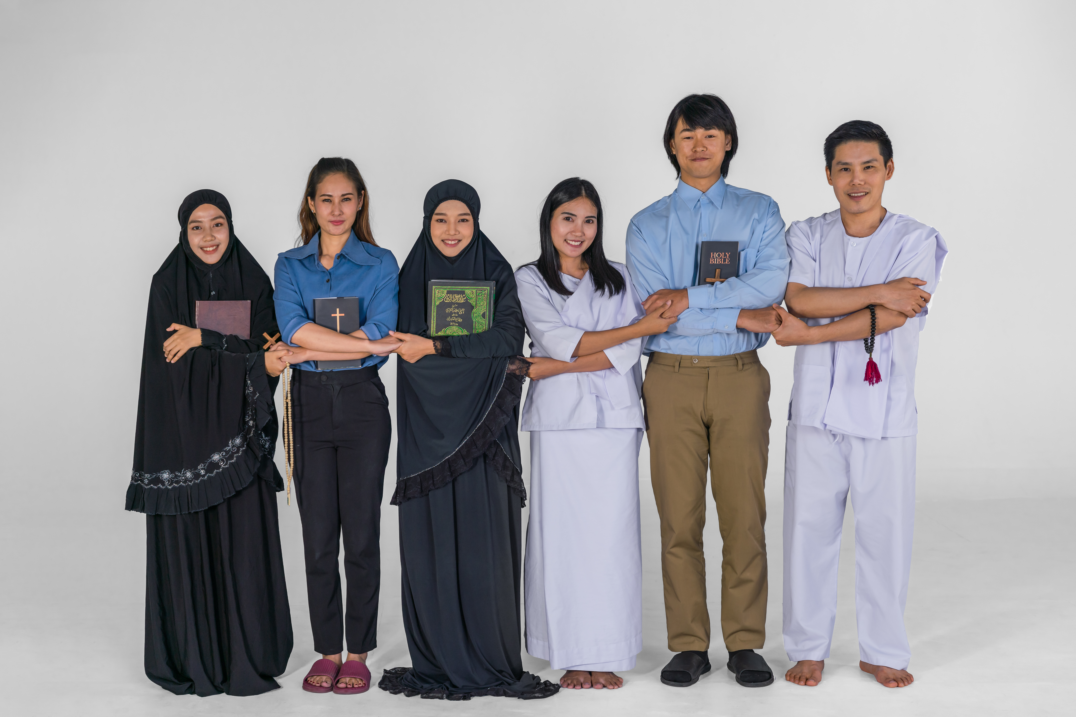
Commitment XVI
“We commit to leverage the spiritual and moral weight of religions and beliefs with the aim of strengthening the protection of universal human rights and developing preventative strategies that we adapt to our local contexts, benefitting from the potential support of relevant UN entities.”
Notes:
Refer participants to the full Commitment and read it out. The point of this slide is to provide background to the participants and provide an anchor for the discussions in this session.
Reading aloud the Commitment at the outset ensures that all participants focus their minds on it. Take the first 10 minutes of the session to read the Commitment, and emphasize the role that religious leaders have in protecting and promoting universal values.
Ask the participants a few questions about the Commitment. Do they find this principle helpful? Is there something missing in the Commitment? If so, what would you add to make the Commitment stronger? What implied actions are presented in Commitment XVI?
The key takeaway from this module is that faith actors can act as powerful agents of peace-building and reconciliation in post-conflict situations and are best placed to prevent religion from being manipulated. However, religious actors can also rely on universal values, which are a common heritage of humanity, to build relationships between divided communities. Faith actors should act as custodians of shared values across all religions and beliefs through social engagement.

Slide 3
Peer-to-Peer Exercise:
TWEETING COMMITMENT XVI
  Summarise this commitment in less than 140 characters and decide how to articulate Commitment XVI in your own words.
Notes:
Now, ask participants to summarise the Commitment in less than 140 characters. This exercise is intended to de-construct and re-construct the Commitment to reenergize the discussions.
It may be useful to frame the question in terms such as, "how can the main points of this commitment be put simply, in a clear and concise way that people in your community would understand?". This can be done with small groups of 3-4.
One possible result could be as follows: "We commit to leveraging the spiritual and moral weight of religions and beliefs to strengthen the protection of universal human rights".

Slide 4
2019 Declaration of the 10th World Assembly of Religions for Peace
To our commitment to the importance of human rights, we add our foundational concern for the cultivation of virtues, those habitual orientations to value that sculpt our human potentials. These include our potentials for the most elevated states of mercy, compassion, and love. For us, the labor to become virtuous is not a solitary act; rather, it is an act of “solidarity;” one that can only be achieved by generosity and mutual love. The cultivation of virtue tackles the ignorance, individual egoism, and group egoism that mutilate authentic community.
Notes:
This quote on the slide, taken from the 2019 Declaration of the 10th World Assembly of Religions for Peace (https://www.rfp.org/declaration-of-the-10th-world-assembly-of-religions-for-peace%EF%BB%BF/), captures the takeaway message of the module clearly. There is a need to focus on common and shared values across religions and beliefs because despite all humans being connected, the world is nonetheless becoming more divided. Celebrating mercy, compassion and love in pursuit of the common good allows humanity to embrace its beauty.
Religious actors have a role in acting as a custodian of these values and ensuring that religious interpretations aren't being manipulated to undermine these values.
Spend 10 minutes discussing the importance of this quote. The following questions may be helpful for the discussion:
Why concepts like mercy, compassion and love are important?
Why do some people consider these concepts as blindly idealistic?
What can be argued against those who would criticize fundamental values?
It may also be useful to draw direct relation to quotes from religious leaders who embrace this, such as the Universal House of Justice (the international governing council of the Bahá’í Faith) who say that "For the first time in history it is possible for everyone to view the entire planet, with all its myriad diversified peoples, in one perspective. World peace is not only possible but inevitable."

Slide 5
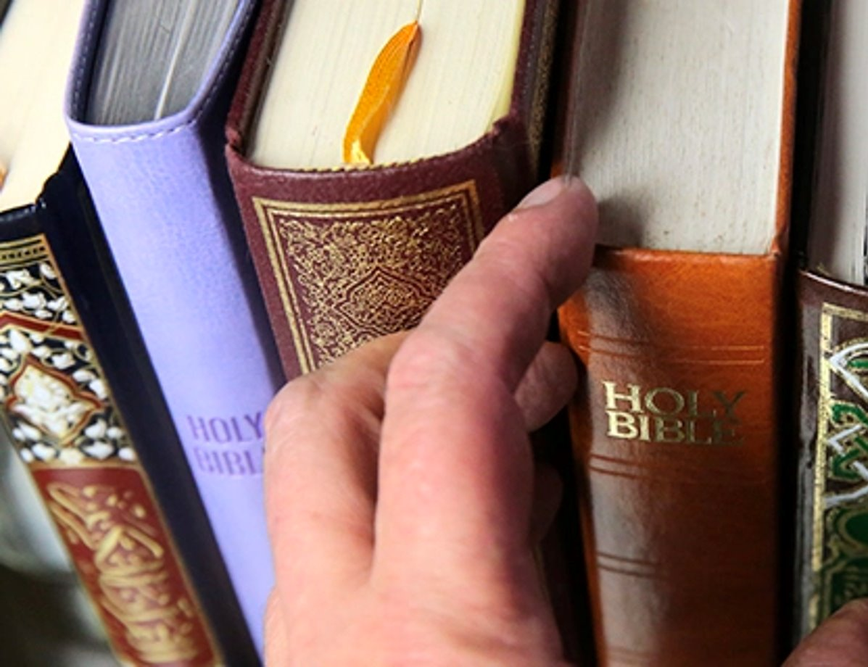
Peer-to-Peer Exercise:
ADDING FAITH QUOTES
"Do unto others as you would have them do unto you."
(Golden Rule).
Think of quotes from your own religion or belief systems that support this commitment.
Notes:
Adding faith quotes (15 minutes)
Distribute the related Handout.
We recommend dividing the participants into small groups (ca. 4-5 people) so everyone can feel safe contributing to the discussion.
Ask participants to think about their own religious or non-religious traditions and whether they are aware of any quotes that they are aware of that are related to the Commitment in question.
Start with the quote in the slide: "Do unto others as you would have them do unto you." (Golden Rule)
Other quotes that can be relied on are:
“Love your neighbour as yourself. There is no commandment greater than these” (Mark 12: 31)
“The God-conscious being is always unstained, like the sun, which gives its comfort and warmth to all. The God-conscious being looks upon all alike, like the wind, which blows equally upon the king and the poor beggar.” (Guru Granth Sahib p. 272)
“The religion of God and His divine law are the most potent instruments and the surest of all means for the dawning of the light of unity amongst men. The progress of the world, the development of nations, the tranquility of peoples, and the peace of all who dwell on earth are among the principles and ordinances of God.”(Baha’u’llah)
Sharing with the larger group (5 minutes)
Ask participants from each group to share their quotes and briefly explain why they chose them.
Write down the quotes on a poster board or flip chart so everyone can see them.

Slide 6
Peer-to-Peer Exercise:
UNPACKING
  Why is this commitment important?
  What are the different components of the commitment?
  What are the corresponding action points to these components?
  Who are the stakeholders that would take those actions?
Notes:
This activity consists of three parts, with the first being individual reflections for 5 minutes, the second discussing those individual reflections in a small group for 10 minutes, and the third sharing the perspectives with the larger group for 5 minutes.
The four questions on the handout focus on listing the elements, action points and stakeholders.
The key takeaway is to recognize the complexity of these issues whilst seeking to move forward with the commitment.
This exercise, taken from the #Faith4Rights toolkit, does not attempt to raise and resolve all the issues in relation to neutrality in humanitarian action; it merely seeks to indicate the complexity and interconnectedness of all the issues.
This is a highly recommended activity as it gives participants the opportunity to unpack the commitment and address it specifically in their own community. However, the Facilitator should emphasize the need to focus on a limited discussion to prevent derailing into a wider discussion around related subjects.

Slide 7
Peer-to-Peer Exercise:
STORYTELLING
What experience do you have in leveraging the spiritual and moral weight of belief in order to make an impact on a human rights issue?
In what areas outside your ethical or spiritual community have you experienced mercy, compassion, and love?
How do the diverse experiences of others contribute to your own understanding of these values?
Notes:
In this activity, participants are encouraged to discuss their own personal experiences in upholding this Commitment. It is useful for participants to see how these issues can be tackled in different ways.
Facilitators should encourage participants to lead on this and build on each other's stories, but it may be helpful to guide them with questions such as:
What experience do you have in leveraging the spiritual and moral weight of belief in order to make an impact on a human rights issue?
In what areas outside your ethical or spiritual community have you experienced mercy, compassion, and love?
How do the diverse experiences of others contribute to your own understanding of these values?

Slide 8
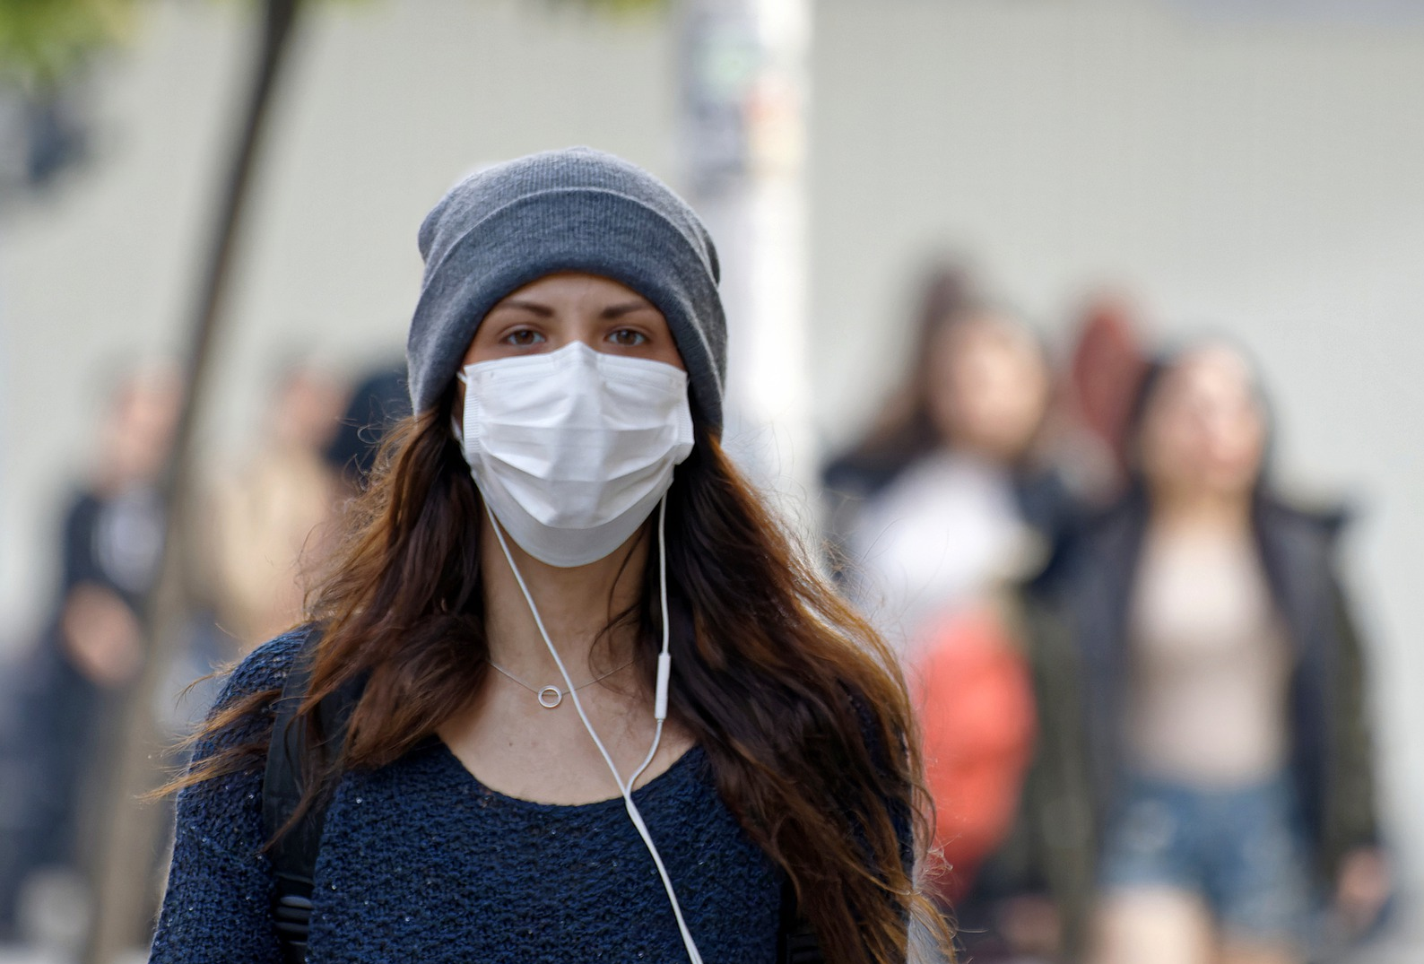
Peer-to-Peer Exercise:
A CASE TO DEBATE ON AN EPIDEMIC
Questions
What are the reprehensible acts and statements by the leaders of A-Religion and B-Religion?
How does the order of the Prime Minister of Itneconni violate international human rights law?
What would be the reaction of your religious or belief community in a similar scenario?
Notes:
Give the participants the Handout – case on an epidemic.
Divide the participants into small groups and ask them to spend 15 minutes reading and discussing the questions of the case.
Return to the larger group and ask the participants to share their findings, spending 5 minutes on each of the questions on the slide.
The Facilitator may wish to refer to the op-ed (https://www.unhcr.org/news/stories/coronavirus-outbreak-test-our-systems-values-and-humanity) by UN High Commissioners for Refugees, Filippo Grandi, and former UN High Commissioners for Human Rights, Michelle Bachelet, concerning the coronavirus outbreak as a test of our systems, values and humanity (10 March 2020): “When fear and uncertainty kick in, scapegoats are never far away. We have already seen anger and hostility directed at some people of East Asian origin. If left unchecked, the urge to blame and exclude may soon extend to other groups – minorities, the marginalized or anyone labelled ‘foreigner’. […] Ceding space to rumour, fear-mongering and hysteria will not only hamper the response but may have broader implications for human rights, and the functioning of accountable, democratic institutions. No country today can wall itself off from the impact of the coronavirus, both in the literal sense and – as falling stock markets and closed schools demonstrate – economically and socially. An international response that ensures that developing countries are equipped to diagnose, treat and prevent this disease will be crucial to safeguarding the health of billions of people.”

