Slide 1
Module 14 of the #Faith4Rights toolkit
Impartiality
Notes:
Facilitator Notes:
This session uses the #Faith4Rights toolkit, specifically module 14. This peer-to-peer learning module emphasizes discussion and participant interaction. This module focuses on the necessity of neutrality at the heart of humanitarian action.
Faith-based organizations have an important role in providing humanitarian assistance, but this also runs the danger of being delivered in a discriminatory manner which involves forced conversions. This needs to be addressed as our capacity to provide help to the poor and needy regardless of ethnic, national or religious boundaries is fundamental to the heart of humanity.

Slide 2
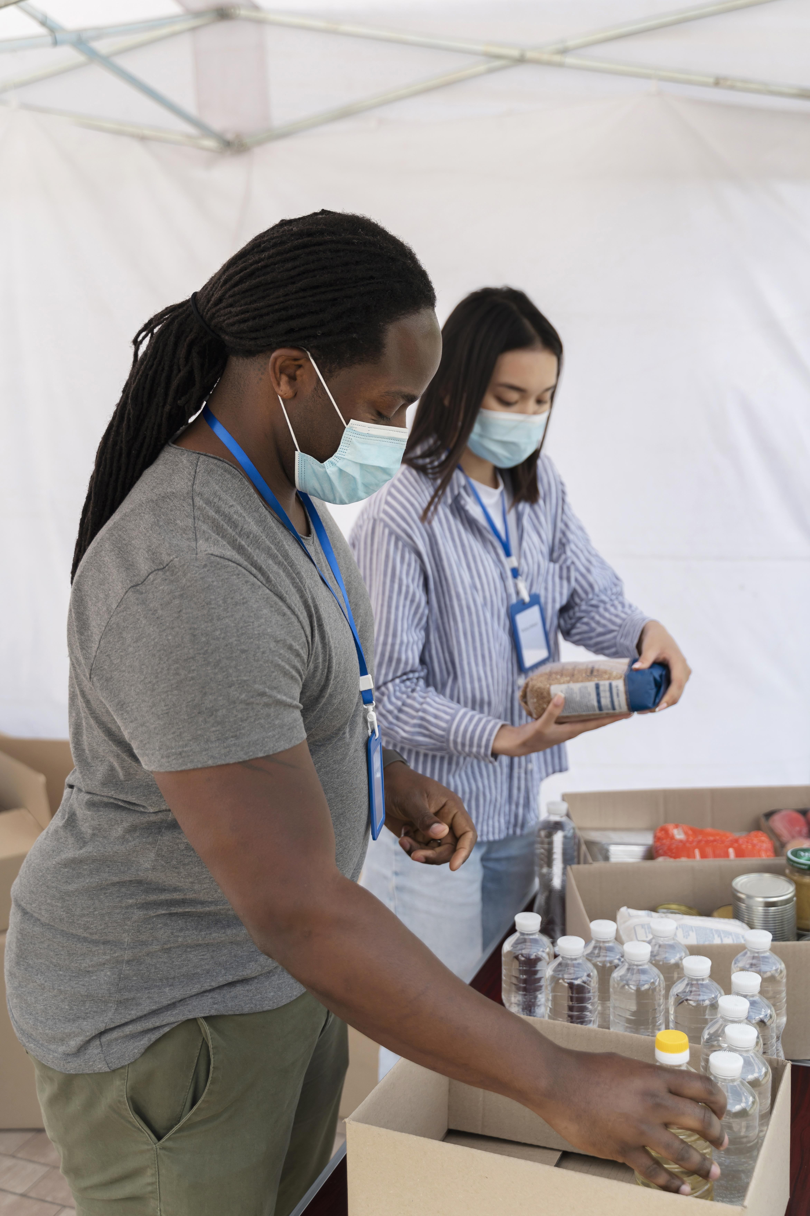
Commitment XIV
“We pledge to promote, within our respective spheres of influence, the imperative necessity of ensuring respect in all humanitarian assistance activities of the Principles of Conduct for the International Red Cross and Red Crescent Movement and NGOs in Disaster Response Programmes, especially that aid is given regardless of the recipients’ creed and without adverse distinction of any kind and that aid will not be used to further a particular religious standpoint.”
Notes:
Refer participants to the full commitment and read it out. The point of this slide is to provide background to the participants and provide an anchor for the discussions in this session.
Reading aloud the commitment at the outset ensures that all participants focus their minds on it. Take the first 5 minutes of the session to read the commitment and emphasize the role that religious leaders have in ensuring religion is not used as a tool to discriminate when providing humanitarian assistance.
The key takeaway from this module is that any effective humanitarian action cannot depend on discrimination based on creed or religion, and it should not be used to further a religious standpoint.

Slide 3
Peer-to-Peer Exercise:
TWEETING COMMITMENT XIV
  Summarise this commitment in less than 140 characters and decide how to articulate Commitment XIV in your own words.
Notes:
Now, ask participants to summarise the commitment in less than 140 characters. This exercise is intended to de-construct and re-construct the commitment to reenergize the discussions.
It may be useful to frame the question in terms such as, "how can the main points of this commitment be put simply, in a clear and concise way that people in your community would understand?". This can be done with small groups of 3-4.
One possible result could be as follows: "We commit to ensure that humanitarian aid is given regardless of the recipients’ creed and will not be used to further a religion".

Slide 4
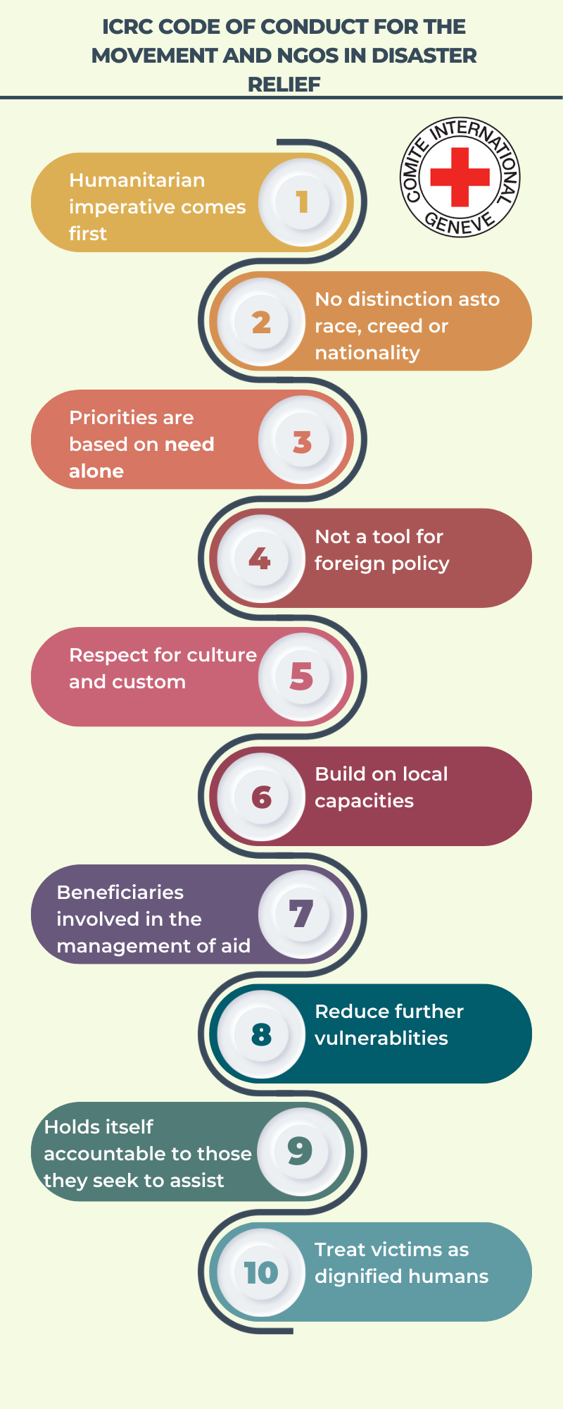
Code of Conduct for the International Red Cross
Which of these principles do you think is the most important?
Are there any principles that you find difficult to be applied in practice?
Notes:
This section focuses on the principles of neutrality that underpin how international humanitarian organizations act and respond to crises. The 10 Principles of Conduct for the International Red Cross and Red Crescent Movement and NGOs in Disaster Response Programmes (not to be confused with the 7 Fundamental Principles of the ICRC, explored in activity 2 below), is a good example of the limits that faith actors should follow when acting in the humanitarian field.
Take 15 minutes to discuss all principles, focusing on any that the participants want to discuss further.
The ten principles are the following:
The humanitarian imperative comes first;
Aid is given regardless of the race, creed or nationality of the recipients and without adverse distinction of any kind;
Aid priorities are calculated on the basis of need alone;
Aid will not be used to further a particular political or religious standpoint. We shall endeavour not to act as instruments of government foreign policy;
We shall respect culture and custom;
We shall attempt to build disaster response on local capacities;
Ways shall be found to involve programme beneficiaries in the management of relief aid;
Relief aid must strive to reduce future vulnerabilities to disaster as well as meeting basic needs;
We hold ourselves accountable to both those we seek to assist and to those from whom we accept resources;
In our information, publicity and advertizing activities, we shall recognize disaster victims as dignified human beings, not hopeless objects.
More information about these principles can be found in the full Code of Conduct document.

Slide 5
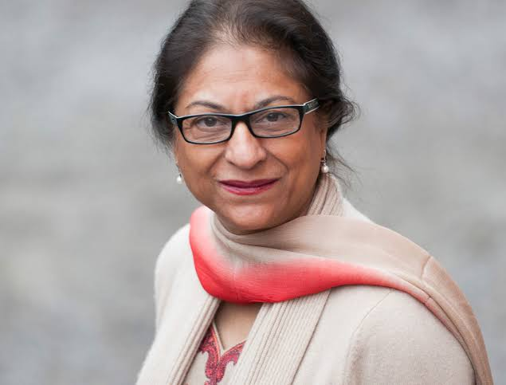
Asma Jahangir
Former Special Rapporteur on freedom of religion or belief
“[R]eligious groups should make a clear separation between their humanitarian efforts and their religious work, respect other religious beliefs in their missionary activities and not use aggressive forms of proselytizing, as they could disturb the atmosphere of religious harmony and provoke further religious intolerance.”
Notes:
This quote from a report (paragraph 120) by the former Special Rapporteur focuses on complaints of 'unethical conversions' by some NGOs with a religious agenda that work in development and humanitarian assistance. This was particularly the case following the 2004 Indian Ocean Tsunami after many international foreign NGOs arrived in Sri Lanka, and some were accused of taking advantage of the disaster to advance their religion.
Spend 10 minutes discussing this quote and other similar examples raised by the participants.

Slide 6
Peer-to-Peer Exercise:
UNPACKING
  Why is this commitment important?
  What are the different components of the commitment?
  What are the corresponding action points to these components?
  Who are the stakeholders that would take those actions?
Notes:
This activity consists of three parts, with the first being individual reflections for 5 minutes, the second discussing those individual reflections in a small group for 10 minutes, and the third sharing the perspectives with the larger group for 5 minutes.
The four questions on the handout focus on listing the elements, action points and stakeholders.
The key takeaway is to recognize the complexity of these issues whilst seeking to move forward with the commitment.
This exercise, taken from the #Faith4Rights toolkit, does not attempt to raise and resolve all the issues in relation to neutrality in humanitarian action; it merely seeks to indicate the complexity and interconnectedness of all the issues.
This is a highly recommended activity as it gives participants the opportunity to unpack the commitment and address it specifically in their own community. However, the Facilitator should emphasize the need to focus on a limited discussion to prevent derailing into a wider discussion around related subjects.

Slide 7
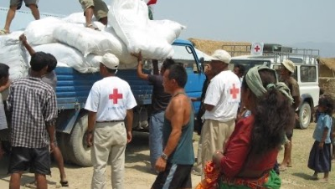
Peer-to-Peer Exercise: EXPLORING
Peer-to-Peer Exercise:
EXPLORING
Notes:
The seven Fundamental Principles of the International Red Cross and Red Crescent Movement are the following: Humanity, impartiality, neutrality, independence, voluntary service, unity and universality.
These seven Fundamental Principles sum up the Movement's ethics and are at the core of its approach to helping people in need during armed conflict, natural disasters and other emergencies.
Watch the Video - ICRC Principles in Action (https://www.youtube.com/watch?v=nTbXHpS4rgU)

Slide 8
Peer-to-Peer Exercise:
EXPLORING
  How are these principles related to your religious or belief tradition?
  How can the lack of neutrality in a conflict situation be redressed through religion?
  What should be the reaction of a religious leader when facing a situation where aid is not given regardless of the recipients' creed?
  Should faith-based humanitarian aid be inclusive, or should charity remain within its own faith boundaries?
  What are the pitfalls and positive aspects of being a faith or belief-based humanitarian organization? How can these pitfalls be overcome?
Notes:
Discuss with the whole group the following questions:
How are these principles related to your religious or belief tradition?
How can the lack of neutrality in a conflict situation be redressed through religion?
What should be the reaction of a religious leader when facing a situation where aid is not given regardless of the recipients' creed?
Should faith-based humanitarian aid be inclusive, or should charity remain within its own faith boundaries?
What are the pitfalls and positive aspects of being a faith or belief-based humanitarian organization? How can these pitfalls be overcome?

Slide 9

Peer-to-Peer Exercise:
ADDING FAITH QUOTES
“Through selfless service, eternal peace is obtained.”
(Guru Granth Sahib 125)
Think of quotes from your own religion or belief systems that support this commitment.
Notes:
Adding faith quotes (15 minutes)
Distribute the related Handout.
We recommend dividing the participants into small groups (ca. 4-5 people) so everyone can feel safe contributing to the discussion.
Ask participants to think about their own religious or non-religious traditions and whether they are aware of any quotes that they are aware of that are related to the commitment in question.
Start with the quote provided in the slide: "Through selfless service, eternal peace is obtained." (Guru Granth Sahib 125)
Sharing with the larger group (5 minutes)
Ask participants from each group to share their quotes and briefly explain why they chose them.
Write down the quotes on a poster board or flip chart so everyone can see them.

