Slide 1
Module 1 of the #Faith4Rights toolkit
Freedom of conscience
Notes:
Facilitator Notes:
Welcome the participants to the session and explain that it will focus on Module 1 of the Faith for Rights Toolkit, looking at freedom of conscience

Slide 2
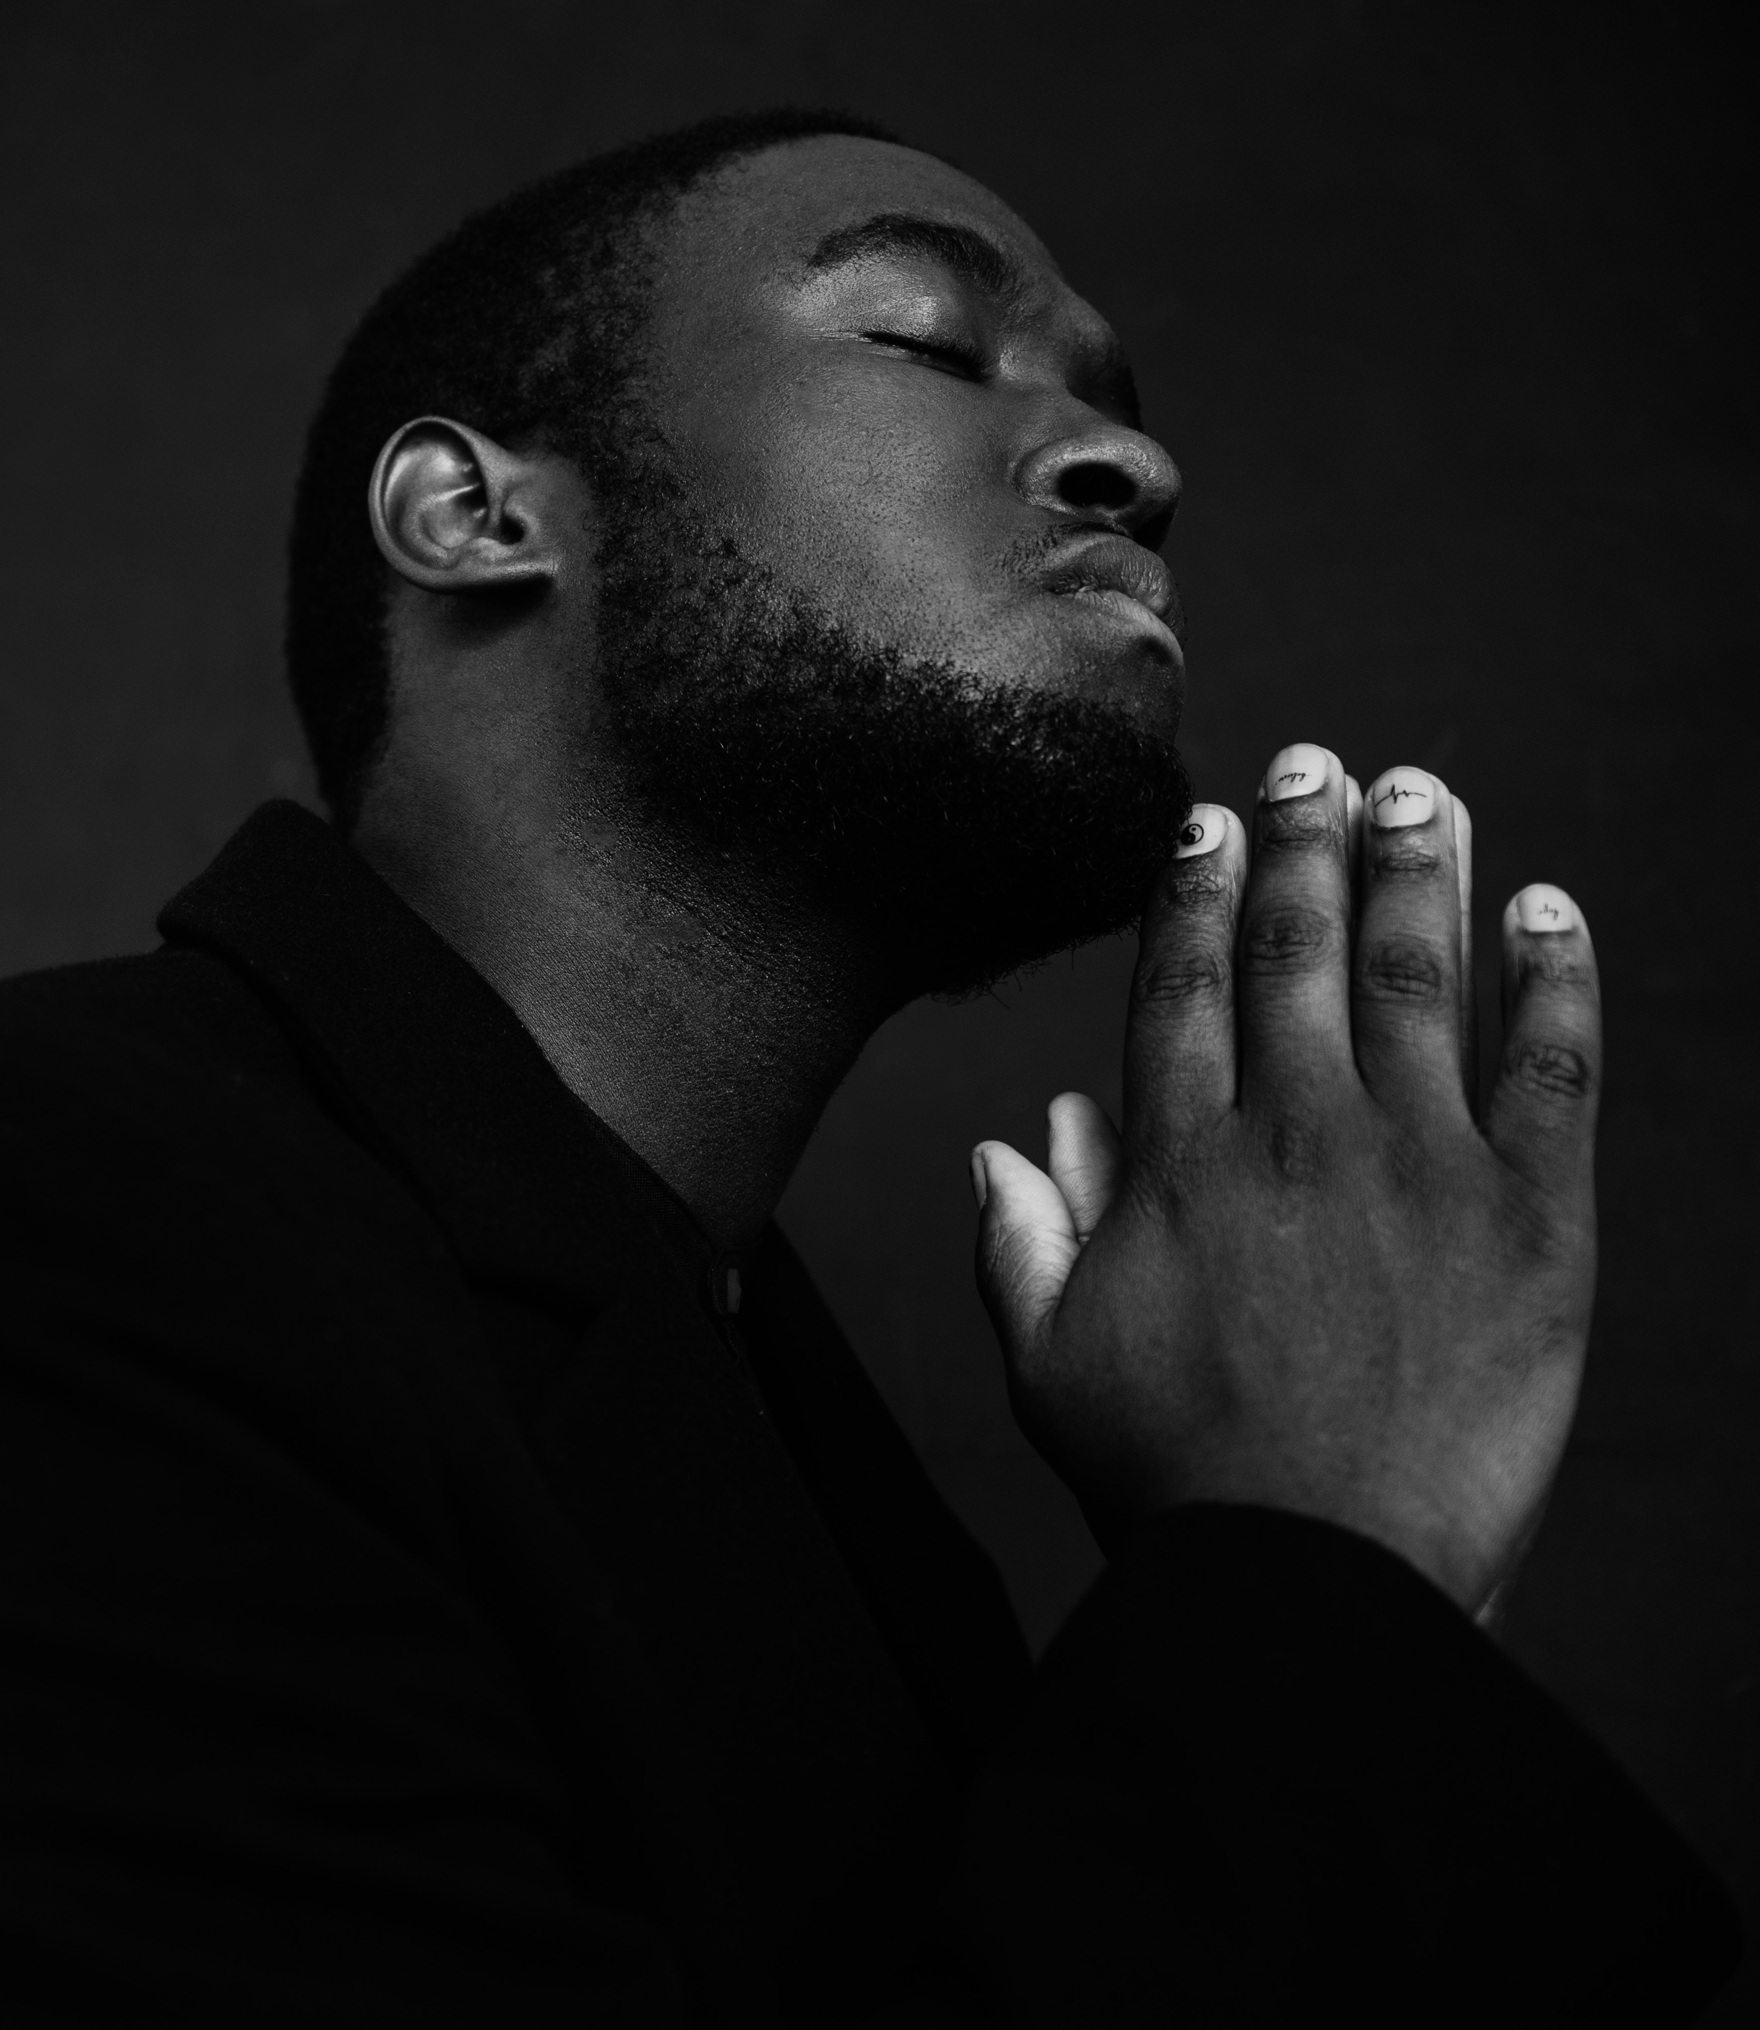
Commitment I
“Our most fundamental responsibility is to stand up and act for everyone’s right to free choices and particularly for everyone’s freedom of thought, conscience, religion or belief.”
Notes:
Read out the commitment and establish the focus on the right to choose freely between religions and beliefs. This action aims to provide background to the participants and anchor the discussion on Commitment 1. This also ensures that all participants focus their minds on it.
Pose these questions to participants, contributing to the discussion with further inputs:
How do you define conscience? What's important about it?
Conscience is one of the key things that makes us human; the ability to make choices based on one's own sense of right and wrong is a fundamental virtue, and the freedom of conscience is wider than the freedom of religion or belief. The freedom of conscience covers ethics and values that someone values, whether or not this is a recognized religious attitude.
This freedom cannot be limited, and everyone has this right. This means that one's personal convictions cannot be imposed with coercion on others.
What does freedom of conscience mean to you?
What are some of the difficulties with protecting this freedom?
There are obvious difficulties with this freedom; the freedom to value things by your own views means that you are open to the judgment and criticism of others.
However, what is needed the most in this area is that we all stand up to defend everyone's right to their own convictions.

Slide 3
Commitment I
“We affirm our commitment to the universal norms and standards, including Article 18 of the of the ICCPR which does not permit any limitations whatsoever on the freedom of thought and conscience or on the freedom to have or adopt a religion or belief of one’s choice. These freedoms, unconditionally protected by universal norms, are also sacred and inalienable entitlements according to religious teachings.”
Notes:
Read out the commitment and establish the focus on the right to choose freely between religions and beliefs. This action aims to provide background to the participants and anchor the discussion on Commitment 1. This also ensures that all participants focus their minds on it.
Pose these questions to participants, contributing to the discussion with further inputs:
How do you define conscience? What's important about it?
Conscience is one of the key things that makes us human; the ability to make choices based on one's own sense of right and wrong is a fundamental virtue, and the freedom of conscience is wider than the freedom of religion or belief. The freedom of conscience covers ethics and values that someone values, whether or not this is a recognized religious attitude.
This freedom cannot be limited, and everyone has this right. This means that one's personal convictions cannot be imposed with coercion on others.
What does freedom of conscience mean to you?
What are some of the difficulties with protecting this freedom?
There are obvious difficulties with this freedom; the freedom to value things by your own views means that you are open to the judgment and criticism of others.
However, what is needed the most in this area is that we all stand up to defend everyone's right to their own convictions.

Slide 4
Commitment I
“These freedoms, unconditionally protected by universal norms, are also sacred and inalienable entitlements according to religious teachings.”
Notes:
Read out the commitment and establish the focus on the right to choose freely between religions and beliefs. This action aims to provide background to the participants and anchor the discussion on Commitment 1. This also ensures that all participants focus their minds on it.
Pose these questions to participants, contributing to the discussion with further inputs:
How do you define conscience? What's important about it?
Conscience is one of the key things that makes us human; the ability to make choices based on one's own sense of right and wrong is a fundamental virtue, and the freedom of conscience is wider than the freedom of religion or belief. The freedom of conscience covers ethics and values that someone values, whether or not this is a recognized religious attitude.
This freedom cannot be limited, and everyone has this right. This means that one's personal convictions cannot be imposed with coercion on others.
What does freedom of conscience mean to you?
What are some of the difficulties with protecting this freedom?
There are obvious difficulties with this freedom; the freedom to value things by your own views means that you are open to the judgment and criticism of others.
However, what is needed the most in this area is that we all stand up to defend everyone's right to their own convictions.

Slide 5
Module 1 and Article 18 of the ICCPR
  Article 18, paragraph 1, of the International Covenant on Civil and Political Rights
  “Everyone shall have the right to freedom of thought, conscience and religion. This right shall include freedom to have or to adopt a religion or belief of his choice, and freedom, either individually or in community with others and in public or private, to manifest his religion or belief in worship, observance, practice and teaching”
Notes:
Linking back to the second session, the facilitator should emphasize how these sessions touch on matters that all interlink. This module from the #F4R toolkit builds on the right in Article 18 of the International Covenant on Civil and Political Rights. It is also rooted in religious thought and belief, and it is useful to convey to the participants the dynamic nature of the interaction between faith and rights.

Slide 6
Module 1 and Article 18 of the ICCPR
  Article 18, paragraph 2, of the International Covenant on Civil and Political Rights
  “No one shall be subject to coercion which would impair his freedom to have or to adopt a religion or belief of his choice.”
Notes:
Linking back to the second session, the Facilitator should emphasize how these sessions touch on matters that all interlink. This module from the #F4R toolkit builds on the right in Article 18 of the International Covenant on Civil and Political Rights. It is also rooted in religious thought and belief, and it is useful to convey to the participants the dynamic nature of the interaction between faith and rights.

Slide 7
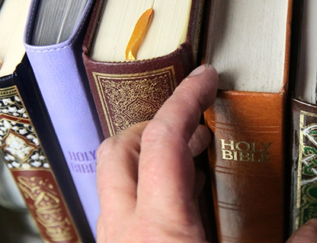
Peer-to-Peer Exercise
ADDING FAITH QUOTES
“There shall be no compulsion in religion.” (Qur’an 2:256)
Think of quotes from your own religion or belief systems that support this commitment. Discuss in your small groups, and report back in 5 minutes.
Notes:
Adding faith quotes (PPT slide 7) (10 minutes)
We recommend small groups (ca. 4-5 people) so everyone can feel safe contributing to the discussion .
Ask participants to think about their own religious or non-religious traditions and whether they are aware of any quotes that they are aware of that could be used to defend freedom of conscience.
Start by providing a quote yourself, such as "There shall be no compulsion in religion." (Qur'an 2:256).
Distribute the Module 1 - Freedom of Conscience - Handout Activity 1.
Ask participants to share their knowledge. Spend at least 5 minutes discussing these quotes and linking them to Article 18.
Other quotes that can be relied on are;
"The Truth is from your Lord; so let he or she who please believe and let he or she who please disbelieve" (Qur'an 18:29);
"But if serving the Lord seems undesirable to you, then choose for yourselves this day whom you will serve..." (Joshua 24:15)
No one shall coerce another; no one shall exploit another. Everyone, each individual, has the inalienable birthright to seek and pursue happiness and self-fulfilment. Love and persuasion is the only law of social coherence." (Guru Granth Sahib, p. 74)
"When freedom of conscience, liberty of thought and right of speech prevail—that is to say, when every man according to his own idealization may give expression to his beliefs—development and growth are inevitable." ('Abdu'l-Baha)
"People should aim to treat each other as they would like to be treated themselves – with tolerance, consideration and compassion." (Golden Rule)
Sharing with the larger group (5 min)
Ask participants from each group to share their quotes and briefly explain why they chose them.
Write down the quotes on a poster board or flip chart so everyone can see them I think we can avoid having participants feel reluctant to speak out if we ask them to do this activity in smaller groups.

Slide 8
Peer-to-Peer Exercise
UNPACKING COMMITMENT I
  Why is this commitment important?
  What are the different components of the commitment?
  What are the corresponding action points to these components?
  Who are the stakeholders that would take those actions?
Notes:
Activity 2 - Unpacking the Commitment (PPT slide 8) Duration: 25 minutes
This activity consists of three parts, with the first being individual reflections for 5 minutes. The second is discussing those personal reflections as a group for 15 minutes. The third is sharing the findings with the larger group for 5 minutes.
The four questions focus on listing the elements, action points and stakeholders.
Personal Reflection (PPT slide 7) (5 minutes)
In the first 5 minutes, participants should reflect on the three questions independently. They may use the template table provided in "Module 1 - Freedom of Conscience - Handout Activity 2".
Small group discussion (PPT slide 7) (15 minutes)
Participants should spend 15 minutes discussing their personal reflections on those questions. The purpose of this is to allow participants to recognize that there are various readings of the same commitment. This diversity allows for different views on who holds what responsibilities, both at the state and non-state levels.
Sharing with the larger group (5 minutes)
Ask participants from each group to briefly share their thoughts.
Write down the ideas on a poster board or flip chart so everyone can see them.

