Slide 1
Freedom of Religion or Belief in Theory and Practice
Exploring Basic principles of international law, human rights, and the right to freedom of religion or Belief
Notes:
Facilitator Notes
Freedom of religion or belief is a human right. The right has been shaped through millennia, in different cultural and religious traditions. Nowadays, this right is present in most countries, be that in Constitutions or other legal arrangements. Since this is an international training event, we will focus on the international legal definition of freedom of religion or belief provided for in treaties drafted by the United Nations. In order to understand the context in which these rights were drafted, we will employ the following structure:
Step 1: Short introduction about international and regional organizations, with particular focus on the United Nations. (10 minutes)
Step 2: Short introduction about international and regional human rights treaties. Freedom of religion is one human right which is connected to several other human rights. These rights are provided for in international and regional treaties. We will briefly explore a few of them to understand their importance. (15 minutes)
Step 3: Short introduction about freedom of religion or belief. In this step we will explore more in depth the different legal aspects of the right to freedom of religion or belief. (20 minutes)
Step 4: Storytelling. That you be the time for you to share your thoughts about the importance of freedom of religion or belief in your life. (15 minutes)

Slide 2
  International and regional organizations
OSCE
Council of Europe
(CoE)
European Union
Organization of American States
(OAS)
United Nations (UN)
Association of Southeast Asian Nations
(ASEAN)
African Union
(AU)
ECOWAS
Notes:
This slide illustrates a few international and regional organizations that work on human rights issues.
International and regional organizations are founded by treaties, and States voluntarily choose to be a member.
These organizations offer benefits to States but also require them to fulfil some duties.
We will now focus on the United Nations, which has 193 members (that is, most recognized States in the world).

Slide 3
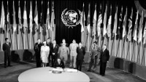
  United Nations
Notes:
This video is a bit old, celebrating the 75th Anniversary of the UN in 2020, but it summarises the importance of the United Nations: https://www.youtube.com/watch?v=8e8jngVUo68
The video focuses on the United Nations Charter, the founding document of the UN.
The UN was created out of necessity in order to minimize conflicts that had devastated the world. As the Charter expresses in the first lines of the Preamble:
“WE THE PEOPLES OF THE UNITED NATIONS DETERMINED
to save succeeding generations from the scourge of war, which twice in our lifetime has brought untold sorrow to mankind.”

Slide 4
UN Charter – Preamble (1945)
We the Peoples of the United Nations determined […]
to reaffirm faith in fundamental human rights, in the dignity and worth of the human person, in the equal rights of men and women and of nations large and small,
In your opinion, what does it mean to:
reaffirm faith in fundamental human rights?
reaffirm faith in the dignity and worth of the human person?
reaffirm faith in the equal rights of men and women?
Notes:
The second point made by the UN Charter in its Preamble is the following:
“WE THE PEOPLES OF THE UNITED NATIONS DETERMINED
[…] to reaffirm faith in fundamental human rights, in the dignity and worth of the human person, in the equal rights of men and women and of nations large and small,”
This quote highlights the vital role of human rights in the post second World War period. States have experienced the destructive effects of wars and must now reaffirm their faith in human rights, and act accordingly in order to avoid future conflicts.
Ask the participants the following questions. In your opinion, what does it mean to:
reaffirm faith in fundamental human rights?
* Human rights already existed before the UN in several legal and religious traditions
reaffirm faith in the dignity and worth of the human person?
* Dignity is a broad term, not defined in order not to exclude anyone. Many religious and philosophical traditions have developed this concept for centuries.
reaffirm faith in the equal rights of men and women?
* Although a controversial topic in some circles, religious and philosophical traditions have also addressed this issue.

Slide 5
  Examples of Human Rights Treaties
CoE
European Convention on Human Rights (1950 -1953)
OAS
American Convention on Human Rights (1969)
AU
African Charter on Human and Peoples' Rights (1981)
United Nations
International Covenant on Civil and Political Rights (1966)
Convention against Torture (1984)
Convention on the Rights of the Child (1989)
International Convention on the Protection of the Rights of All Migrant Workers and Members of Their Families (1990)
Notes:
Some international and regional organizations have human rights treaties.
Slide 5 shows some examples of these treaties, some regional, some available to all States.

Slide 6
Treaties are law
Vienna Convention on the Law of Treaties (1969)
Article 26. "pacta sunt servanda"
Every treaty in force is binding upon the parties to it and must be performed by them in good faith.
Notes:
This part is a bit technical, but fundamental to understanding human rights treaties.
The Vienna Convention on the Law of Treaties (1969) provides in Article 26 an ancient principle of law called "pacta sunt servanda". This maxim simply means that agreements must be fulfilled. In international law, this means that "Every treaty in force is binding upon the parties to it and must be performed by them in good faith."
States freely choose to be a party to a treaty. Therefore, they must fulfil the obligations that the treaty imposes on them.
In other words, treaties are not mere ideals; they are the law for States that choose to be bound by them. They legally bind States.

Slide 7
Treaties are law
Vienna Convention on the Law of Treaties (1969)
Article 27 Internal law and observance of treaties
A party may not invoke the provisions of its internal law as justification for its failure to perform a treaty. This rule is without prejudice to article 46.
Notes:
Article 27 further explains that if a State chooses to be bound by a treaty, it cannot use its own law to justify not fulfilling such a treaty.
Consequently, when States commit to be a party to a human rights treaty (ratify a treaty), they are fully aware that these treaties impose legal obligations on them.

Slide 8
Human Rights Treaties
Are legally binding treaties negotiated and adopted by States;
Impose legal obligations undertaken voluntarily by States;
Generate three forms of responsibility of the States to:
Respect human rights
Protect human rights
Fulfil human rights
Notes:
Human rights treaties are legally binding treaties negotiated and adopted by States. They are not only ideals; they are legal in nature.
Human rights treaties impose legal obligations undertaken voluntarily by States. Because states freely choose to be bound by these treaties, these obligations are not optional; they must be followed.
Human rights treaties generate three forms of responsibility for the States to:
Respect human rights
"The obligation to respect means that States must refrain from interfering with or curtailing the enjoyment of human rights."
Protect human rights
"The obligation to protect requires States to protect individuals and groups against human rights abuses."
Fulfil human rights
"The obligation to fulfil means that States must take positive action to facilitate the enjoyment of basic human rights."
For more information, read the short explainer on the UN website: International Human Rights Law.

Slide 9
The UN Human Rights Treaty System
Specific phenomena
Specific groups
International Convention on the Elimination of All Forms of Racial Discrimination (ICERD)
1965 →1969
Convention on the Elimination of All Forms of Discrimination against Women (CEDAW)
1979 → 1981
Universal Declaration of Human Rights (1948)
International Covenant on Civil and Political Rights (ICCPR)
1966 → 1976
Convention against Torture and other Inhuman, Degrading Treatment or Punishment (CAT)
1984 → 1987
Convention on the Rights of the Child (CRC)
1989 → 1990
International Convention on the Protection of the Rights of All Migrant Workers and Members of Their Families (ICMW)
1990 → 2003
International Covenant on Economic, Social and Cultural Rights (ICESCR) 1966 → 1976
International Convention for the Protection of All Persons from Enforced Disappearance (ICCPED)
2006 → 2010
International Convention on the Rights of Persons with Disabilities (ICRPD)
2006 → 2008
Notes:
The UN has 9 core human rights treaties, which can be categorized as demonstrated in slide 9.
These 9 human rights treaties are linked in slide 10.
The Universal Declaration of Human Rights (UDHR), adopted on 10 December 1948, is the basis for the first two treaties that were adopted: the ICCPR and ICESCR, two covenants covering civil, political, social and cultural rights.
Human Rights Treaties addressing specific phenomena: ICERD, CAT and ICCPED
Vs.
Human Rights Treaties protecting specific groups: CEDAW, CRC, ICRMW and CRPD
Reading of «date →date» is «adopted→entered into force»

Slide 10
The UN Core Human Rights Treaties
Abbreviation | Treaty | Date | Monitoring Body
ICERD | International Convention on the Elimination of All Forms of Racial Discrimination | 21 December 1965 | CERD
ICCPR | International Covenant on Civil and Political Rights | 16 December 1966 | CCPR
ICESCR | International Covenant on Economic, Social and Cultural Rights | 16 December 1966 | CESCR
CEDAW | Convention on the Elimination of All Forms of Discrimination against Women | 18 December 1979 | CEDAW
CAT | Convention against Torture and Other Cruel, Inhuman or Degrading Treatment or Punishment | 10 December 1984 | CAT
CRC | Convention on the Rights of the Child | 20 November 1989 | CRC
ICMW | International Convention on the Protection of the Rights of All Migrant Workers and Members of Their Families | 18 December 1990 | CMW
ICRPD | International Convention on the Rights of Persons with Disabilities | 12 December 2006 | CRPD
ICPPED | International Convention for the Protection of All Persons from Enforced Disappearance | 23 December 2010 | CED
Notes:
Each of the human rights treaties is monitored by a committee of independent experts, also called treaty body. These monitoring bodies operate in a similar way as national courts do in relation to national laws.
This slide shows the abbreviations of these treaties, their full names, the date when they were adopted, and the abbreviation of the monitoring bodies.

Slide 11

  United Nations
Notes:
This video summarizes how treaty bodies function within the UN system: https://www.youtube.com/watch?v=2zpjb6ht0EA&t=25s

Slide 12
Question:
What is the importance of human rights treaties for your religious or belief-based community?
Notes:
Ask to the group

Slide 13

Introduction to freedom of religion or belief
Notes:
Elaborated by the Freedom of Religion or Belief Learning Platform: https://www.youtube.com/watch?v=y9j78cLrvuw&list=PLt8b22BDtfjpFLjgpFvlso_cMUgX7vr8z

Slide 14
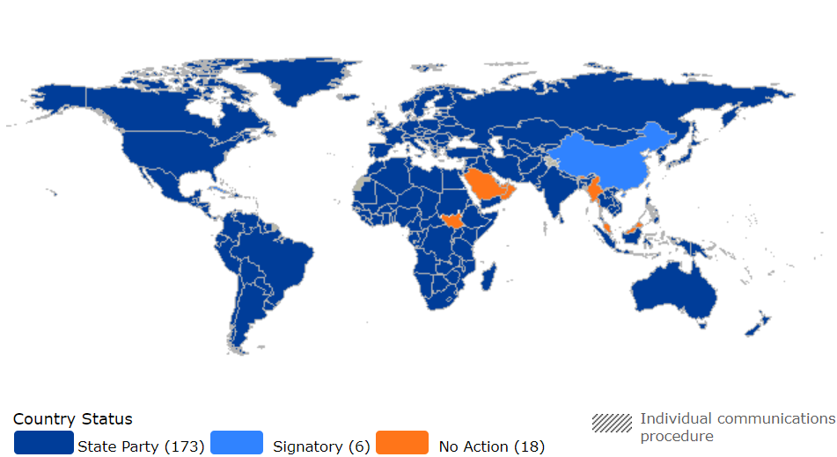
International Covenant on Civil and Political Rights
Notes:
The video mentioned the International Covenant on Civil and Political Rights (ICCPR). This is one of the human rights treaties mentioned before in slides 9 and 10.
The UN has 193 Member States. 173 States have chosen to be a party to the International Covenant on Civil and Political Rights.
This means that the countries in dark blue on the map have to respect, protect, and fulfil the human rights present in the Covenant.
One of these human rights is freedom of religion or belief

Slide 15
International Covenant on Civil and Political Rights
Article 18
Everyone shall have the right to freedom of thought, conscience and religion. This right shall include freedom to have or to adopt a religion or belief of his choice, and freedom, either individually or in community with others and in public or private, to manifest his religion or belief in worship, observance, practice and teaching.
Notes:
Explore what the right to right to freedom of religion or belief involves in accordance with Article 18 of the International Covenant on Civil and Political Rights.
Divide the participants into smaller groups and ask them to spend 3 minutes discussing each paragraph of Article 18 of the International Covenant on Civil and Political Rights.
Article 18 (1) provides for the right to freedom of thought, conscience and religion. Freedom of religion or belief is a short term for this expression.
The right to freedom of thought and conscience is absolute, meaning that the State cannot impose any limitation on these rights.
Article 18 protects theistic, non-theistic and atheistic beliefs, as well as the right not to profess any religion or belief.
Article 18 protects persons with theistic, non-theistic and atheistic beliefs, as well as those who do not want to profess any religion or belief.
Article 18 protects everyone, not only persons from "traditional" religions.
Article 18 (1) provides some examples of what freedom of religion or belief involves, such as freedom to have or to adopt a religion or belief of choice, freedom to manifest religion or belief alone or in community, in public or private, and to manifest one's religion or belief in practice and teaching.

Slide 16
International Covenant on Civil and Political Rights
Article 18
2. No one shall be subject to coercion which would impair his freedom to have or to adopt a religion or belief of his choice.
Notes:
Explore what the right to right to freedom of religion or belief involves in accordance with Article 18 of the International Covenant on Civil and Political Rights.
Divide the participants into smaller groups and ask them to spend 3 minutes discussing each paragraph of Article 18 of the International Covenant on Civil and Political Rights.
Article 18 (2) prohibits coercion to adopt any religion or belief.
Article 18 (2) does not prohibit proselytism or missionary activities, only when these activities involve coercive means.

Slide 17
International Covenant on Civil and Political Rights
Article 18
3. Freedom to manifest one's religion or beliefs may be subject only to such limitations as are prescribed by law and are necessary to protect public safety, order, health, or morals or the fundamental rights and freedoms of others.
Notes:
Explore what the right to right to freedom of religion or belief involves in accordance with Article 18 of the International Covenant on Civil and Political Rights.
Divide the participants into smaller groups and ask them to spend 3 minutes discussing each paragraph of Article 18 of the International Covenant on Civil and Political Rights.
Article 18 (3) provides the conditions that must be observed when the right is exceptionally restricted.
Limitations/restrictions can only be imposed on the right to manifest one's religion or belief, not on their personal convictions.
The conditions the State must fulfil to restrict freedom to manifest religion or belief are legality, legitimacy, and necessity.
The requirement of legality ("prescribed by law") means that the limitation must have some basis in national law.
The requirement of legitimacy means that the restriction must have one of the legitimate aims described in the Article, namely the protection of "public safety, [public] order, [public] health, or [public] morals or the fundamental rights and freedoms of others". The State cannot limit freedom of religion or belief due to any other reason, for instance, national security.
The requirement of necessity means that the limitation must be necessary to achieve one of the abovementioned aims. For example, during the COVID pandemic, the State could deem it necessary to limit people from attending religious gatherings. Nowadays, such a restriction would not be necessary.

Slide 18
International Covenant on Civil and Political Rights
Article 18
4. The States Parties to the present Covenant undertake to have respect for the liberty of parents and, when applicable, legal guardians to ensure the religious and moral education of their children in conformity with their own convictions.
Notes:
Explore what the right to right to freedom of religion or belief involves in accordance with Article 18 of the International Covenant on Civil and Political Rights.
Divide the participants into smaller groups and ask them to spend 3 minutes discussing each paragraph of Article 18 of the International Covenant on Civil and Political Rights.
Article 18(4) provides for the right of parents to raise their children in accordance with their beliefs.
The Convention on the Rights of the Child, in Article 14, provides for the right of the child to freedom of religion or belief

Slide 19
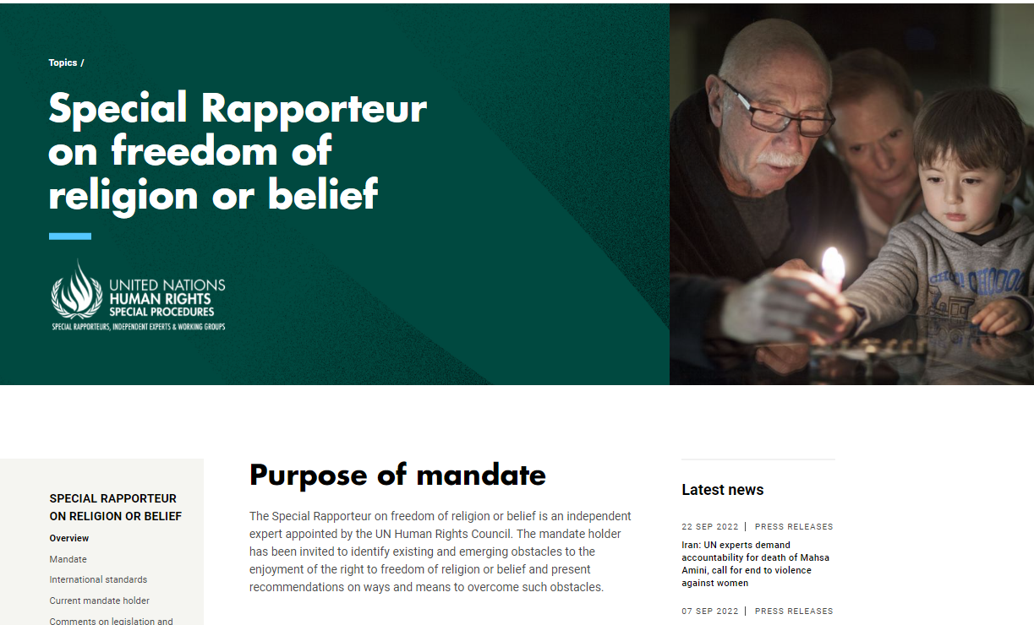
Freedom of religion or belief in practice
Notes:
Freedom of religion or belief is not a theoretical right.
One of the examples of individuals working to protect this right is the UN Special Rapporteur on Freedom of Religion or Belief.
The Special Rapporteur writes thematic reports, visits countries to investigate the situation of freedom of religion in different contexts, and even receives communications from individuals who have their right to freedom of religion or belief violated.
This is an independent and non-paid position.
More information about this expert can be found on the UN website.

Slide 20
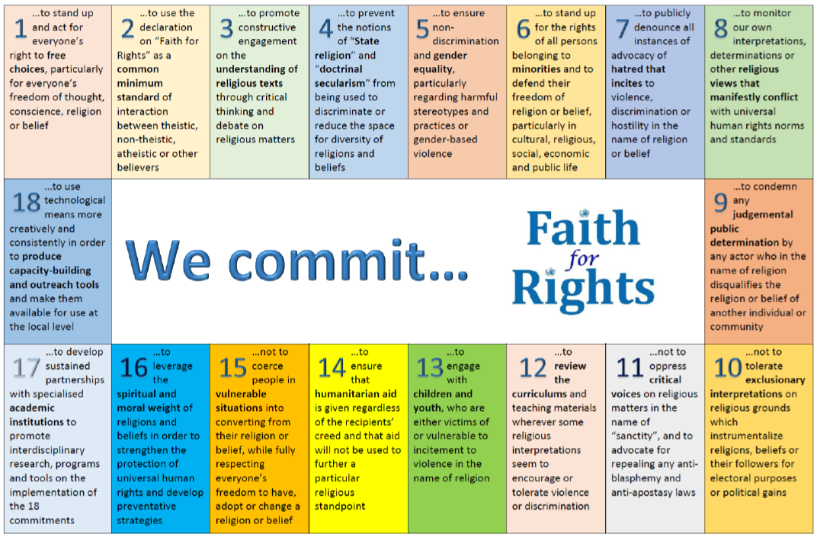
OHCHR AND THE “FAITH FOR RIGHTS” FRAMEWORK
Notes:
Another practical initiative to promote freedom of religion or belief involves the UN Office of the High Commissioner for Human Rights (OHCHR), namely the Faith for Rights project, which this training event is a product of.

Slide 21

Share your own story
What does freedom of religion or belief mean to you?
Has there been a situation where you had to intervene in defense of freedom of religion or belief of somebody who belongs to a different faith/belief group?
How was the situation resolved?
Notes:
Share your own story
What does freedom of religion or belief mean to you?
Has there been a situation where you had to intervene in defense of freedom of religion or belief of somebody who belongs to a different faith/belief group?
How was the situation resolved?
Further questions for personal reflection
What is the relationship between human rights and your work/ministry/vocation?
How do you promote freedom of religion or belief?
What would a world look like without freedom of religion or belief?
List some traditional/scriptural examples that support freedom of thought, conscience and religion?
How is a sense of common humanity and respect for human creation perceived in your belief?

