Slide 1
Introduction
What is Faith for Rights?
Notes:
NOTES to Facilitator:
Session 1 is divided into two parts; one is an introduction to the training event, and the other is an overview of the Faith for Rights framework. The introduction to the training event already follows the principles of peer-to-peer learning. In the Faith for Rights toolkit, these introductory elements can be found in Module 0.
The Faith for Rights training package contains enough learning content to ensure a high level of understanding of the Faith for Rights programme and how it can be used to benefit diverse communities. Therefore, it is not recommended that all of the included material should be utilised. The content is designed so that facilitators will have the opportunity to select material based on the needs and preferences of the audience for which they are preparing the training.

Slide 2

WELCOME
Faith for Rights training event
Notes:
Welcome participants and introduce yourself. Explain that the purpose of this training event is:
To learn about the Faith for Rights framework, what it is and how to use it within their own communities.
To engage in peer-to-peer discussions and activities that will broaden understanding of the Human Rights framework and freedom of conscience.
To contribute their own experiences and viewpoints to important discussions on faith and human rights.
Build connections
Learn how to develop and build Faith for Rights events in their own communities.
Please provide information on the facilities: exits, restrooms, guidelines, etc.
Please provide the agenda for the day, so that participants know what to expect. This should be printed and passed to participants or posted where participants can easily reference it.

Slide 3
Activity 1: Introductory Round (10 min.)
Precisely and concisely introduce yourself:
  What is your name and where are you from?
  What do you hope to gain from this training event?
Notes:
This introductory round should not take a lot of time. Participants should understand that they should take only 1-2 minutes per person. There will be other time allotted throughout the training for more in-depth networking and peer-to-peer discussion. As a facilitator, you may want to begin the introductions by sharing personal expertise or background to model the expectations and set the tone for the session.
Explain to participants:
The brief introductions model the overarching aim of the Faith for Rights sessions: to ensure equal treatment and respectful listening.

Slide 4
Activity 2: Defining Ground Rules
What are some ground rules that can help create a productive and respectful environment for learning and sharing?
Compile an agreed-upon list of rules.
Notes:
In this activity, participants brainstorm and establish ground rules that should be followed throughout the training event.
Begin by reviewing key principles of peer-to-peer learning: such as showing respect for differing perspectives, actively participating in the learning activities, and allowing equal opportunity for everyone to share.
Ask participants to think about ground rules they would like to abide by during their Faith for Rights sessions. Examples may include arriving on time, not using mobile phones during the session, or behaving respectfully towards other participants.
The following questions may be used to guide the discussion:
What are some ground rules that can help create a productive and respectful environment for learning and sharing?
What are some contentions that may arise during discussions about faith and human rights?
What rules might address these contentions?
Provide participants a few minutes to write down suggested rules. They may record these rules in their Training Workbook.
Compile an agreed-upon list of rules. It is best to keep the list simple and brief, try to limit the rules to no more than five.
Write down this list of rules on a poster or board where it will be visible so participants can reference during subsequent sessions.

Slide 5
Activity 3: Brainstorming (5 minutes)
Discuss the following:
  How would you design a training session on faith and rights?
  What approach would you use?
  What resources would you consult?
  Brainstorm key words
Notes:
Divide the participants into small groups of 3 to 4 participants.
This activity should take no longer than 5 minutes. It provides a small amount of time for participants to interact with one another and briefly discuss some key ideas that may be developed later in the training event.
Remind the participants that the purpose is not to develop a comprehensive training strategy, but to suggest key word suggestions that could be developed later.
After 5 minutes, reconvene and ask participants to provide some of their key word ideas. (Take no more than an additional 5 minutes for this discussion).
ALTERNATIVE: Positioning Exercise. (5 to 10 minutes)
Create an invisible “line” from one side of the room to the other. Ask the participants to physically stand on the line in relation to one of the following statements:
What is more important to you: Religion or Rights?
Do you think faith and rights are complementary or separate from each other?
If you engage in this activity please note the following helpful guidelines”
This activity should not be confrontational or presented in a way that participants would feel uncomfortable sharing their view publicly.
Choose only one of the above questions to avoid confusion.
Be clear about which side of the line stands for what option. For example, “the right side of the room signifies the importance of religion, the left side of the room signifies the importance of rights.”
Participants may choose to position themselves somewhere in the middle. That is fine, the “line” should be viewed as a spectrum of thought.
If desired, ask participants to share their logic about why they positioned themselves on the line in a certain place.

Slide 6
What is the
Faith for Rights framework?
FAITH
HUMAN RIGHTS
The FAITH FOR RIGHTS framework provides space for cross-disciplinary reflection and action on the deep, and mutually enriching, connections between religions and human rights.
Notes:
The FFRF provides a space for a cross-disciplinary reflection and action on the connections between religions, beliefs and human rights.
It is an interactive and results-oriented programme for interfaith groups, civil society representatives, and student groups.

Slide 7
What is the
Faith for Rights framework?
FAITH
HUMAN RIGHTS
The OBJECTIVE is to foster the development of peaceful societies, which uphold human dignity and equality for all and where diversity is not just tolerated but fully respected and celebrated.
Notes:
The objective is to Empower people of all faith and belief backgrounds to contribute to fostering peaceful societies and uphold human dignity and equality for all and to develop societies where diversity is not just tolerated but fully respected and celebrated

Slide 8

Five Fundamental Principles
Transcend dialogue to action
Avoid theological divides
Be introspective
Speak with one voice
Act in an independent manner
Notes:
[Click once on this slide to begin text animation]
Give the following explanation to participants regarding the Five Fundamental Principles of the Faith for Rights framework:
The Faith for Rights toolkit is built upon five fundamental principles that guide the facilitator and participants as they participate in peer-to-peer learning:
Transcend dialogue to action: While dialogue is important. It is not an end in itself. Good intentions are of limited value without corresponding action.
Avoid theological divides: While we respect freedom of expression and entertain no illusion as to the continuation of a level of controversy at different levels of religious discourse, we are resolved to challenge the manipulation of religions in both politics and conflicts. We intend to be a balancing united voice of solidarity, reason, compassion, moderation, enlightenment and corresponding collective action at the grassroots level.
Be introspective: Introspectiveness is a cherished virtue. We will all speak up and act first and foremost on our own weaknesses and challenges within our respective communities.
Speak with one voice, particularly against any advocacy of hatred, discrimination or any other violation of the equal dignity that all human beings enjoy regardless of their religion, belief, gender, political or other opinion, national or social origin, or any other status. We have a duty to redress hate speech by remedial compassion and solidarity that heals hearts and societies alike.
Act in an independent manner: Abide by your conscience, while seeking partnerships with religious and secular authorities.
Possible discussion questions:
How can Faith for Rights provide an opportunity for creating a united voice of solidarity, reason, compassion, moderation, enlightenment and corresponding collective action at the grassroots level?
What does it mean to you to act in a fully independent manner while seeking partnerships with religious, governmental, and secular authorities?

Slide 9
18 Commitments
The 18 commitments reach out to people of different religions and beliefs in all regions of the world.
Peer-to-peer learning centered on the 18 commitments serves a triple purpose:
Engage participants to ensure ownership
Encourage critical thinking to face challenges
Reinforce the mutual enhancement between faith and rights
Notes:
[Provide participants with 18 Commitments on “Faith for Rights”]
The 18 modules in the Faith for Rights toolkit are based on the 18 commitments on Faith for Rights. These 18 commitments reach out to people of different religions and beliefs in all regions of the world.
Peer-to-peer learning centered on the 18 commitments serves a triple purpose:
Engage participants to ensure ownership
Encourage critical thinking to face challenges
Reinforce the mutual enhancement between faith and rights

Slide 10
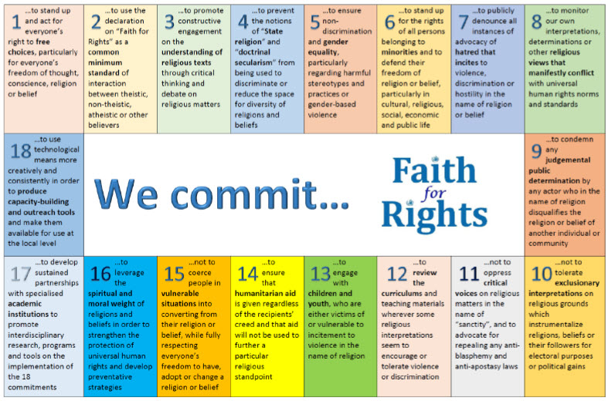
18 Commitments
Notes:
[Provide participants with the Handout - Simplified 18 Commitments on “Faith for Rights”]
The 18 modules in the Faith for Rights toolkit are based on the 18 commitments on Faith for Rights. These 18 commitments reach out to people of different religions and beliefs in all regions of the world.
Peer-to-peer learning centered on the 18 commitments serves a triple purpose:
Engage participants to ensure ownership
Encourage critical thinking to face challenges
Reinforce the mutual enhancement between faith and rights
Engage in a brief discussion with participants about the 18 commitments. Suggested discussion question:
Which of the 18 commitments is most important to you? Why?

Slide 11

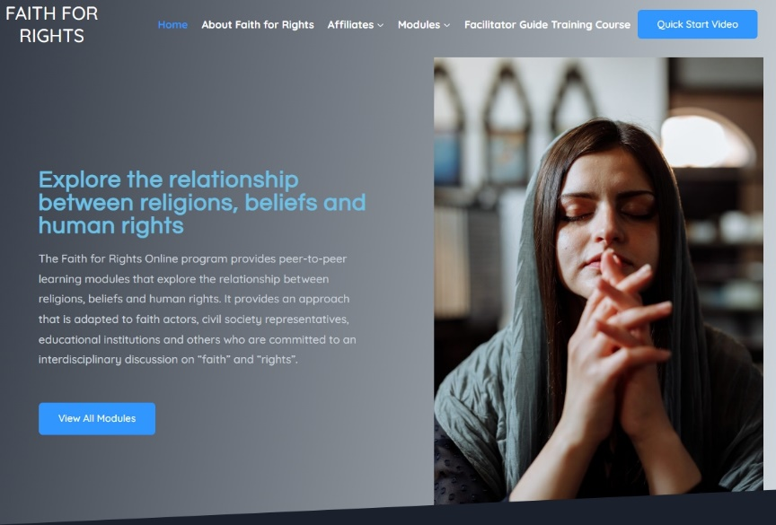
What is the
Faith for Rights Toolkit?
https://www.ohchr.org/en/faith-for-rights/faith4rights-toolkit
https://faith4rights.iclrs.org/
Notes:
The Faith for Rights toolkit contains 18 modules, mirroring each of the commitments on “Faith for Rights” These modules offer concrete ideas for peer-to-peer learning exercises. The whole concept is interactive, result-oriented and conducive to critical thinking. It is open for adaptation by facilitators in order to tailor the modules to the specific context of the participants.
In this training event, you will be provided with experience participating in some of the peer-to-peer learning activities, information on how you can use the Faith for Rights Toolkit, and additional resources that have been developed within the Faith for Rights Framework.

Slide 12

https://www.youtube.com/watch?v=EOxRUKWg430&t=3s
Notes:
Explain to the participants that they will watch this video (https://www.youtube.com/watch?v=EOxRUKWg430&t=3s) to get an overview of the objective of the Faith for Rights framework. After the video there will be a group discussion based on the following questions:
What are ways that you have observed religious leaders defending human rights? How are human rights sometimes undermined by religious leaders?
In your own experience, how are human rights and faith mutually supportive?
How can faith stand up for rights?
Pass out “Introduction to the Faith for Rights Framework – Reflection Questions Handout” questions before starting the video. (Or refer participants to page x in the workbook)

